Slide 1
Transition Path
Electricity Mismatch Analysis

Slide 2
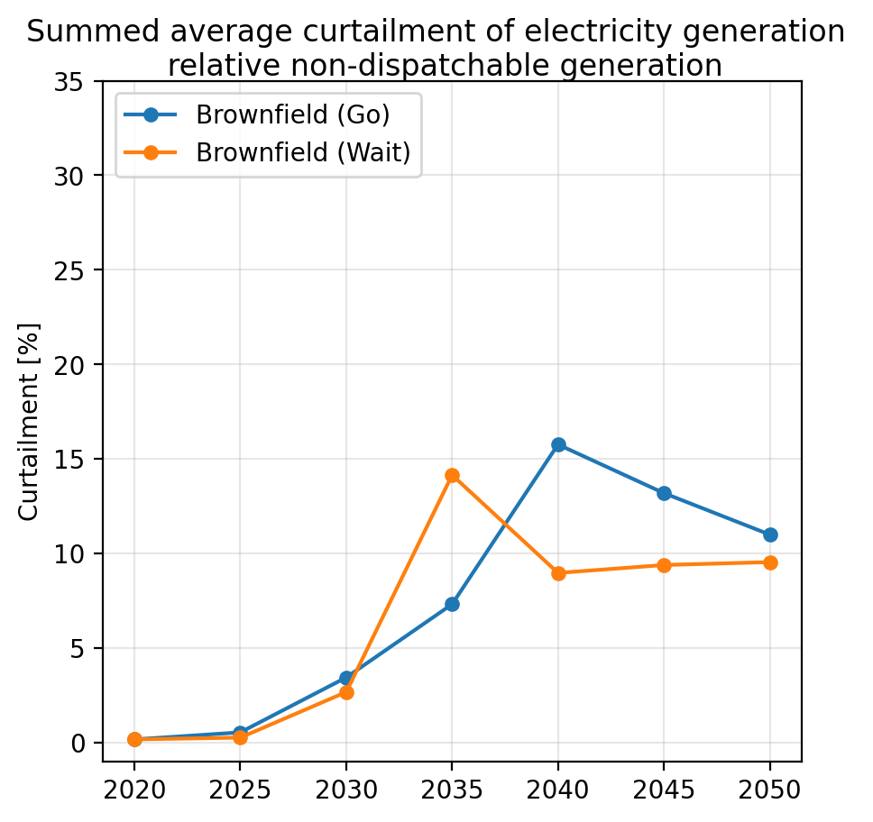
Pre-analysis - Curtailment

Slide 3
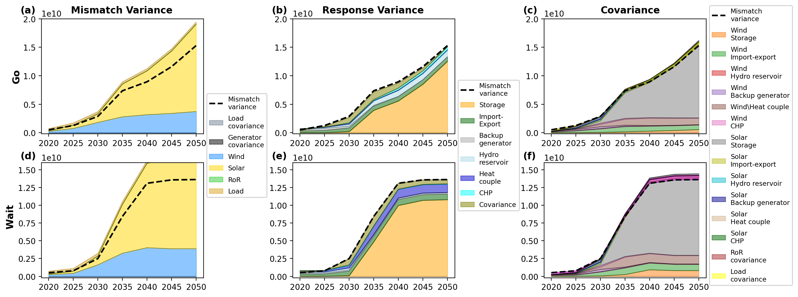
Pre-analysis – Variance & Cross Corilation

Slide 4
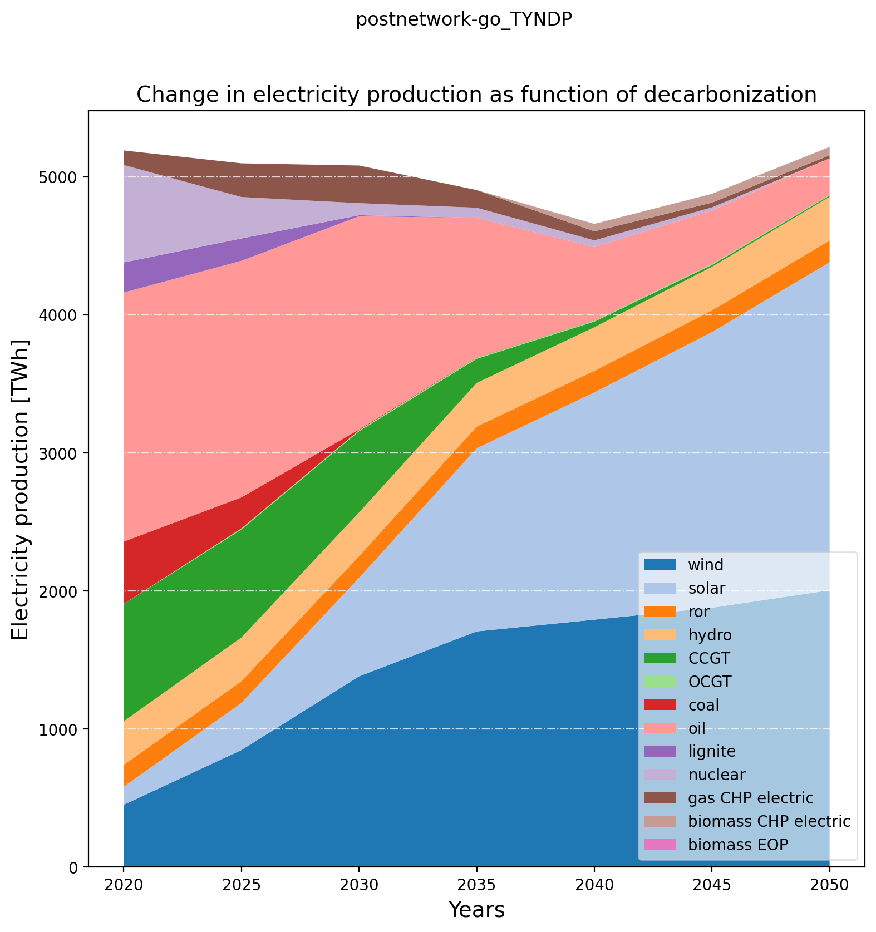
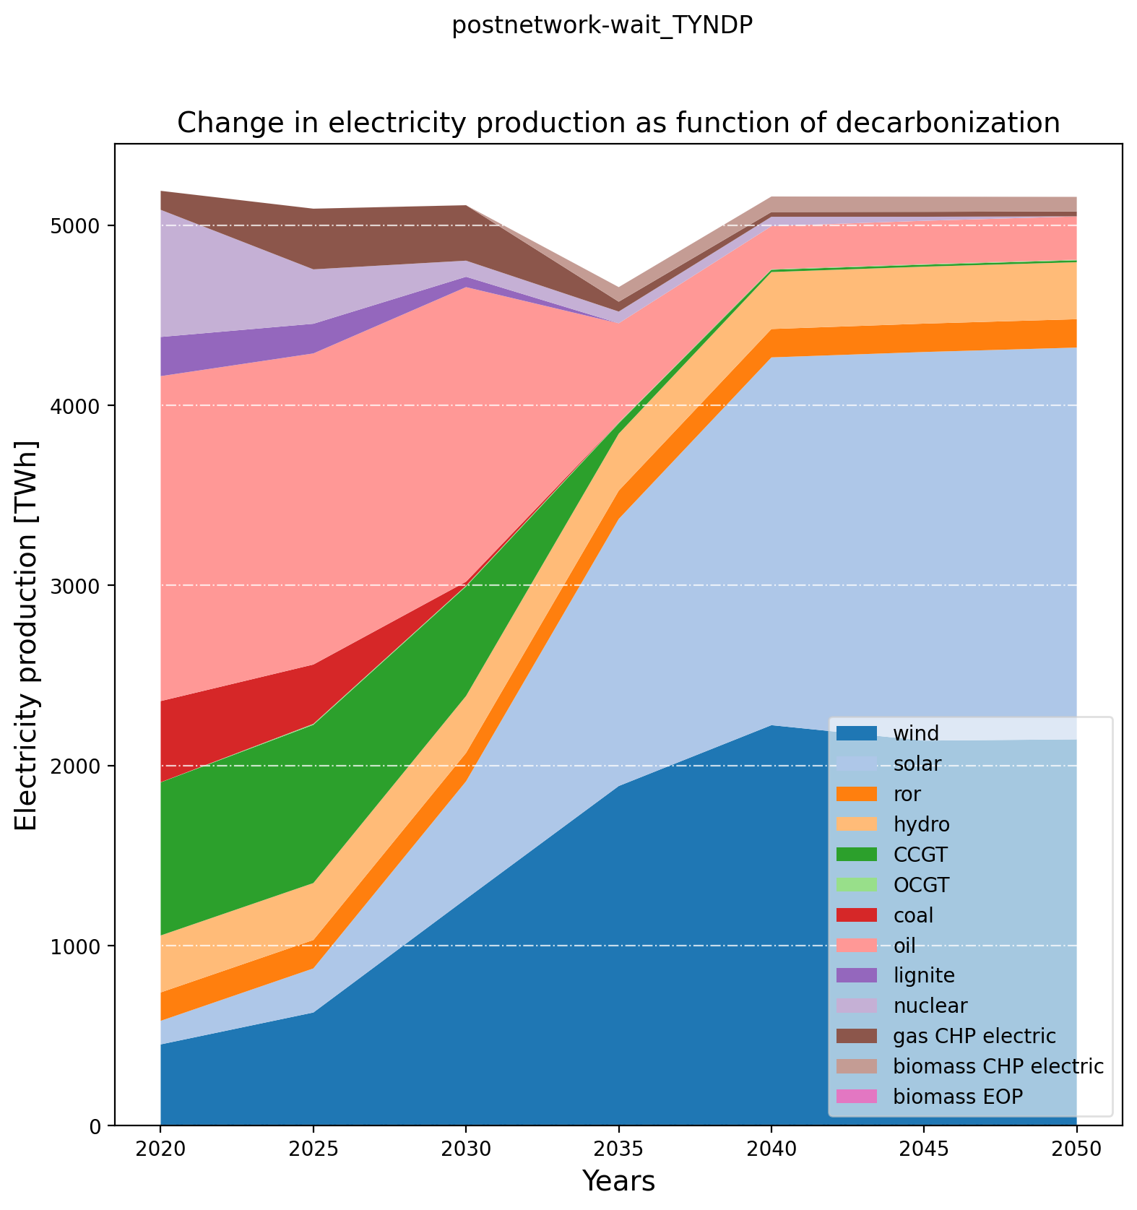
Pre-analysis – Electricity Production

Slide 5
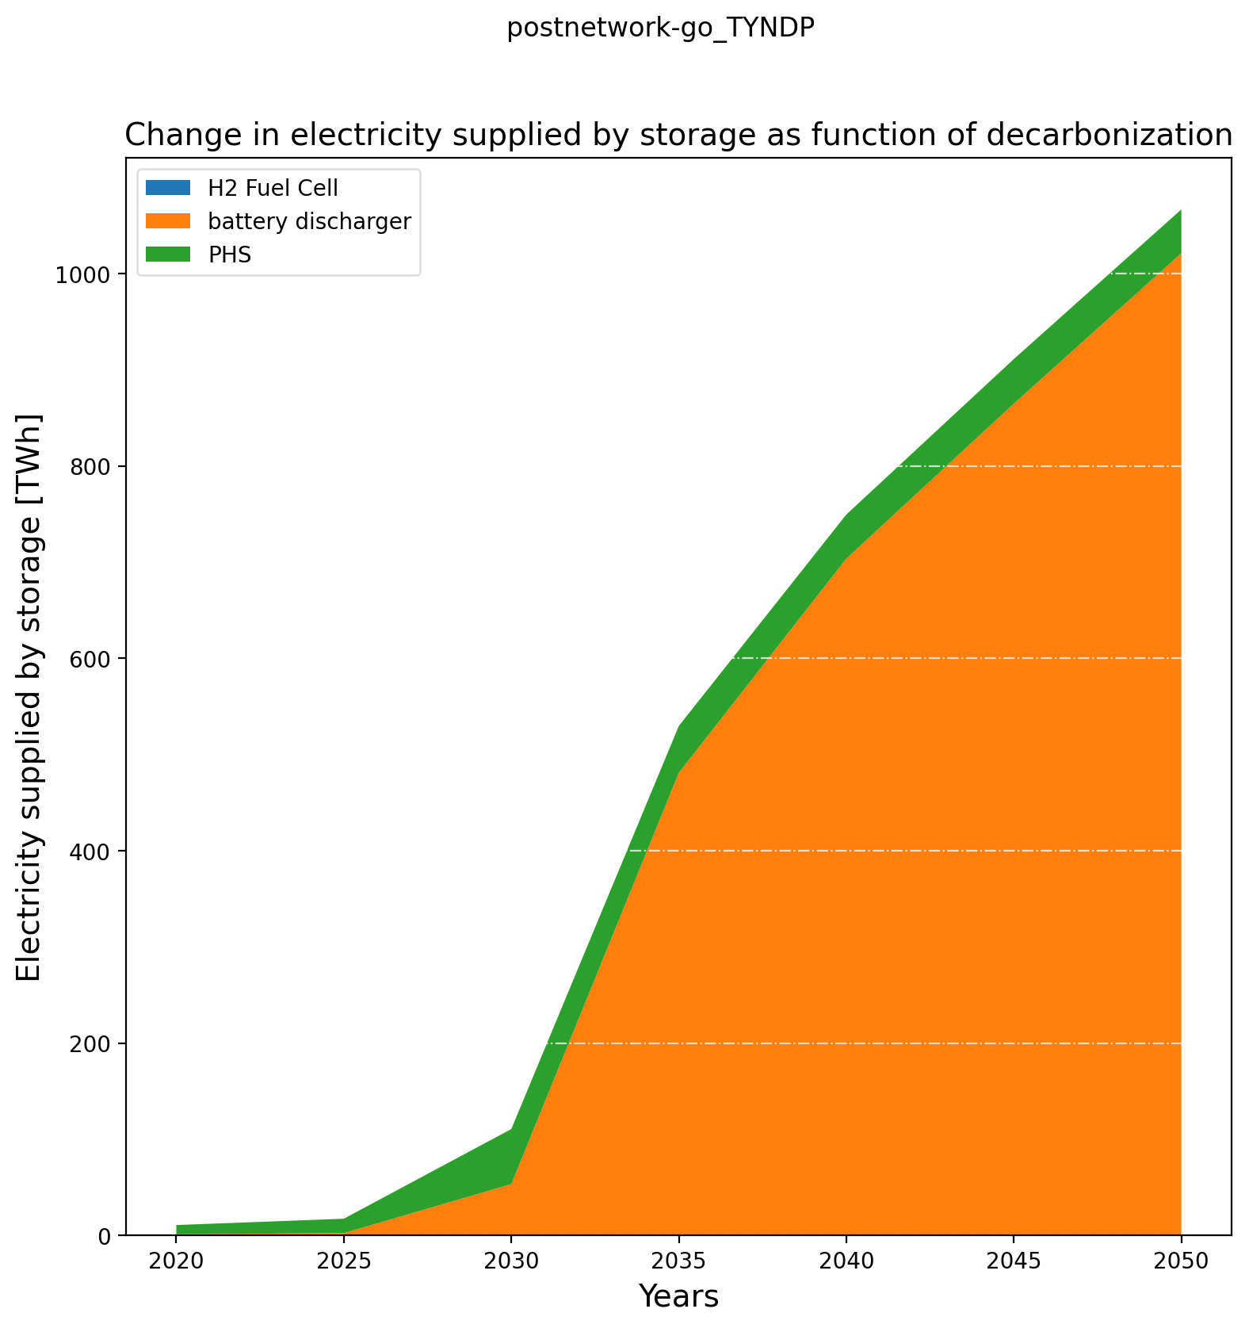
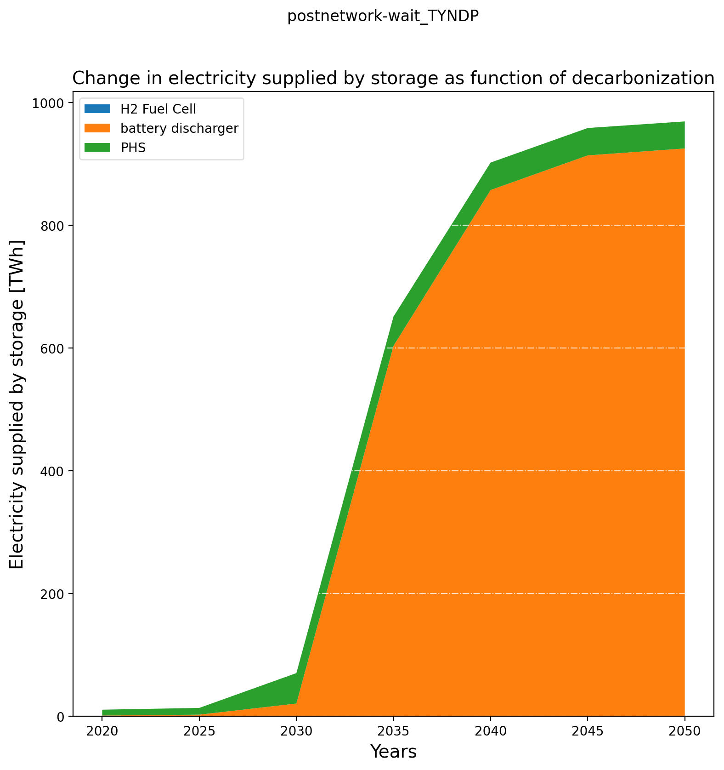
Pre-analysis – Electricity Storage Production

Slide 6
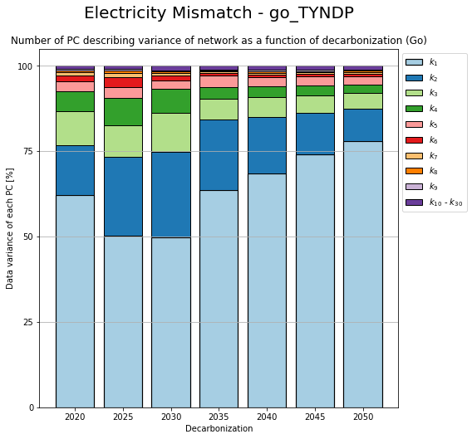
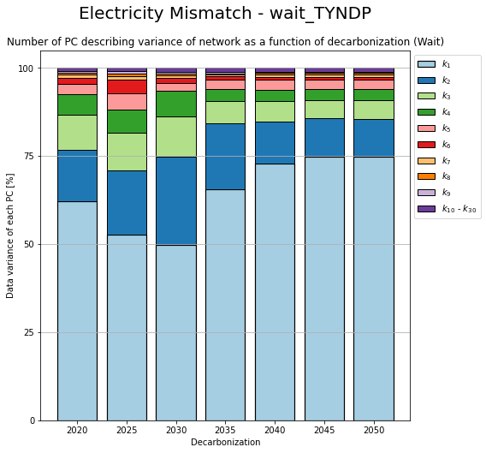
PCA – Change in components

Slide 7
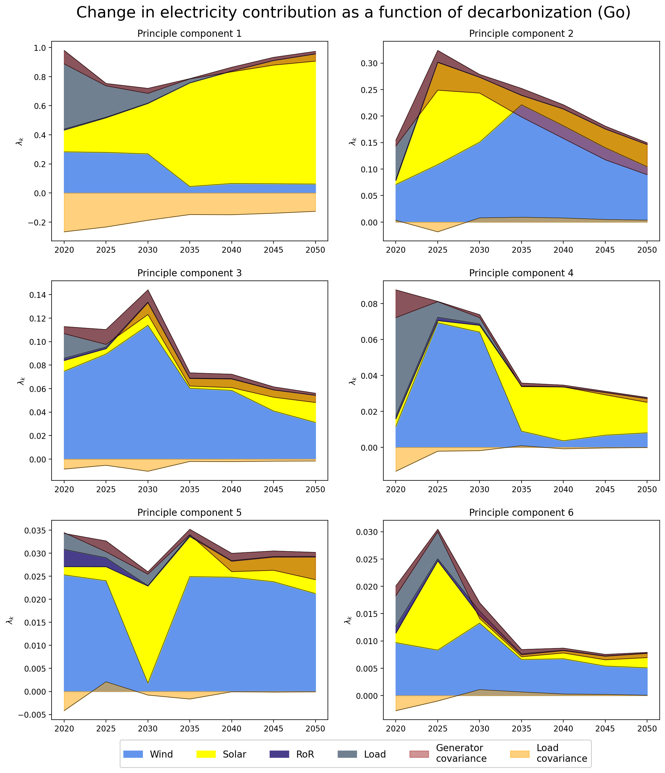
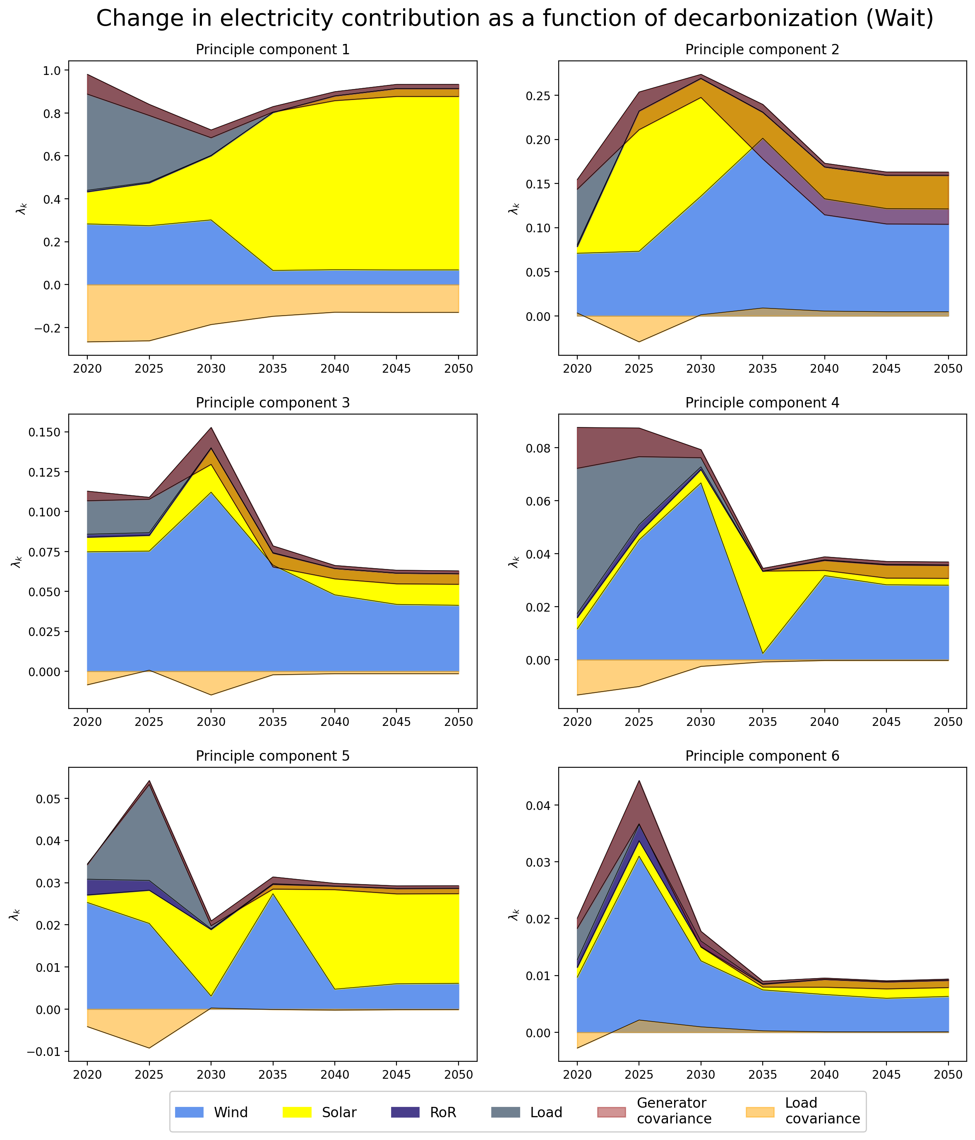
PCA – Change in Contribution

Slide 8
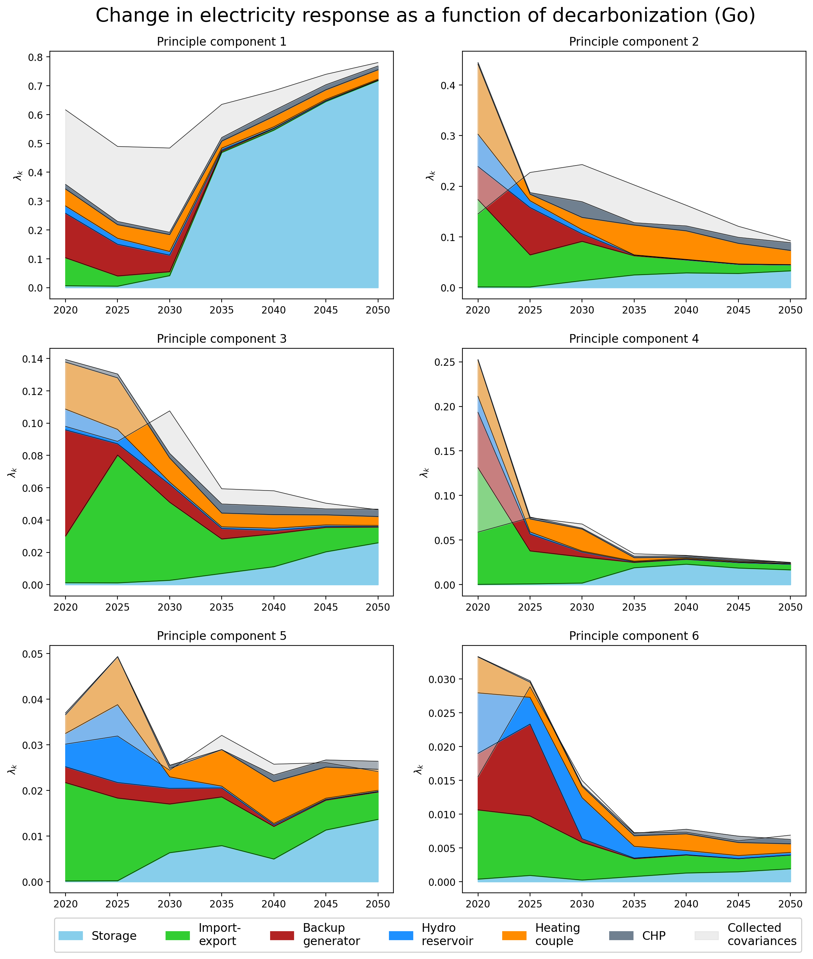
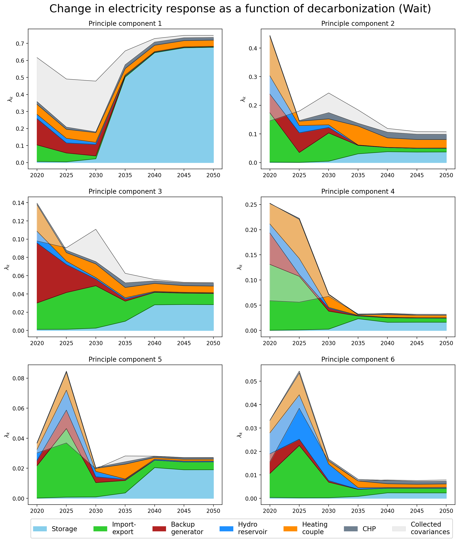
PCA – Change in Response

Slide 9
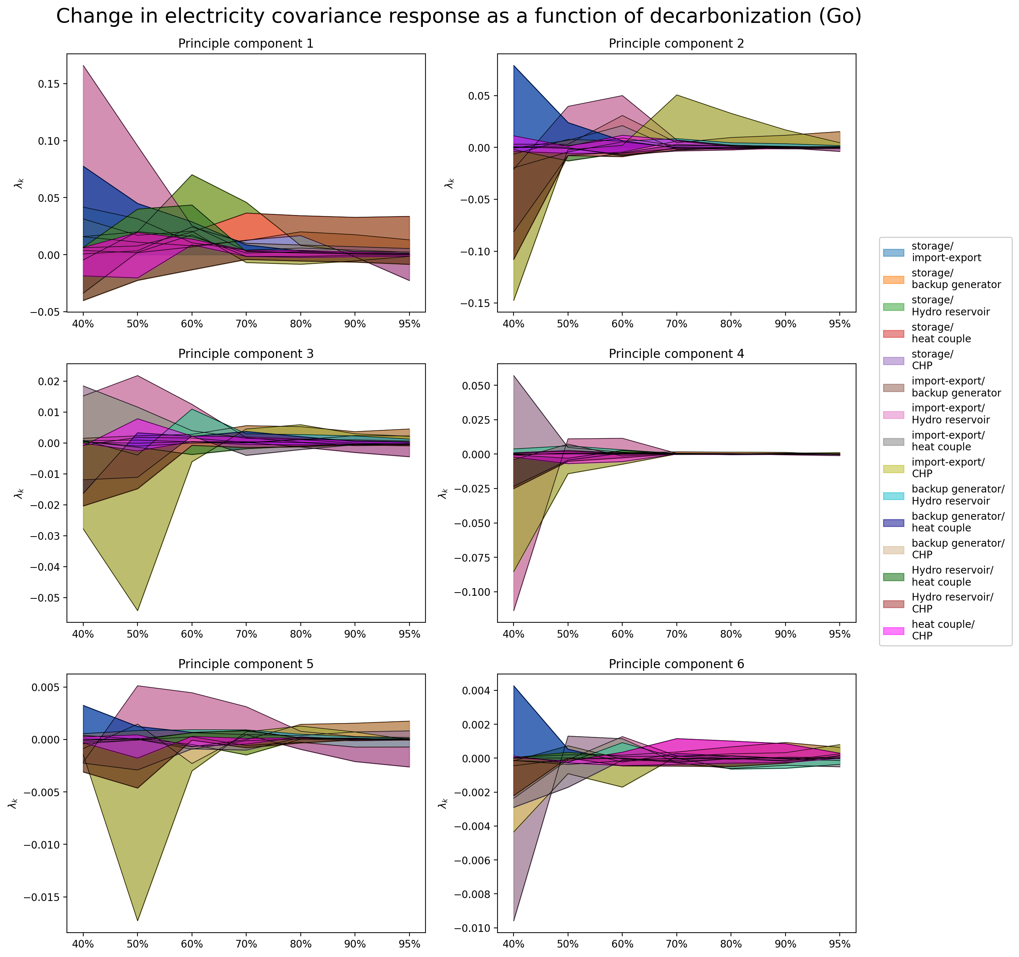
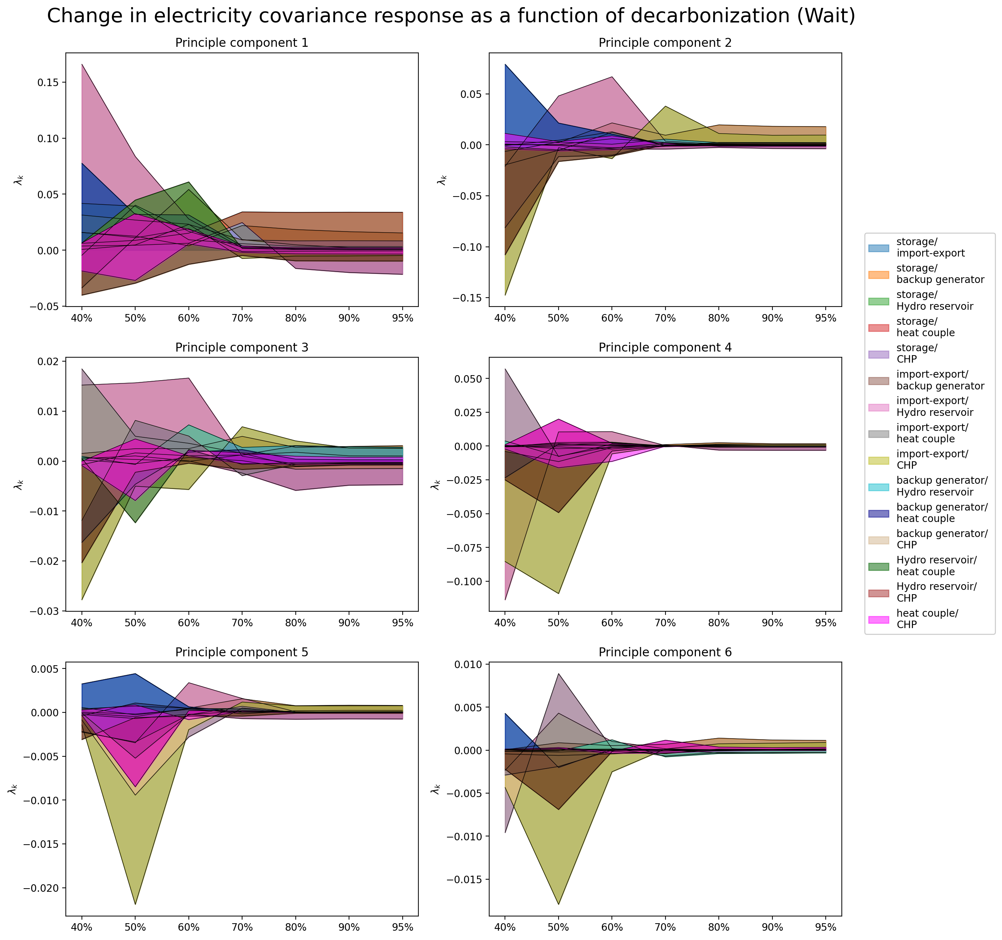
PCA – Change in Response (covariance terms)

Slide 10
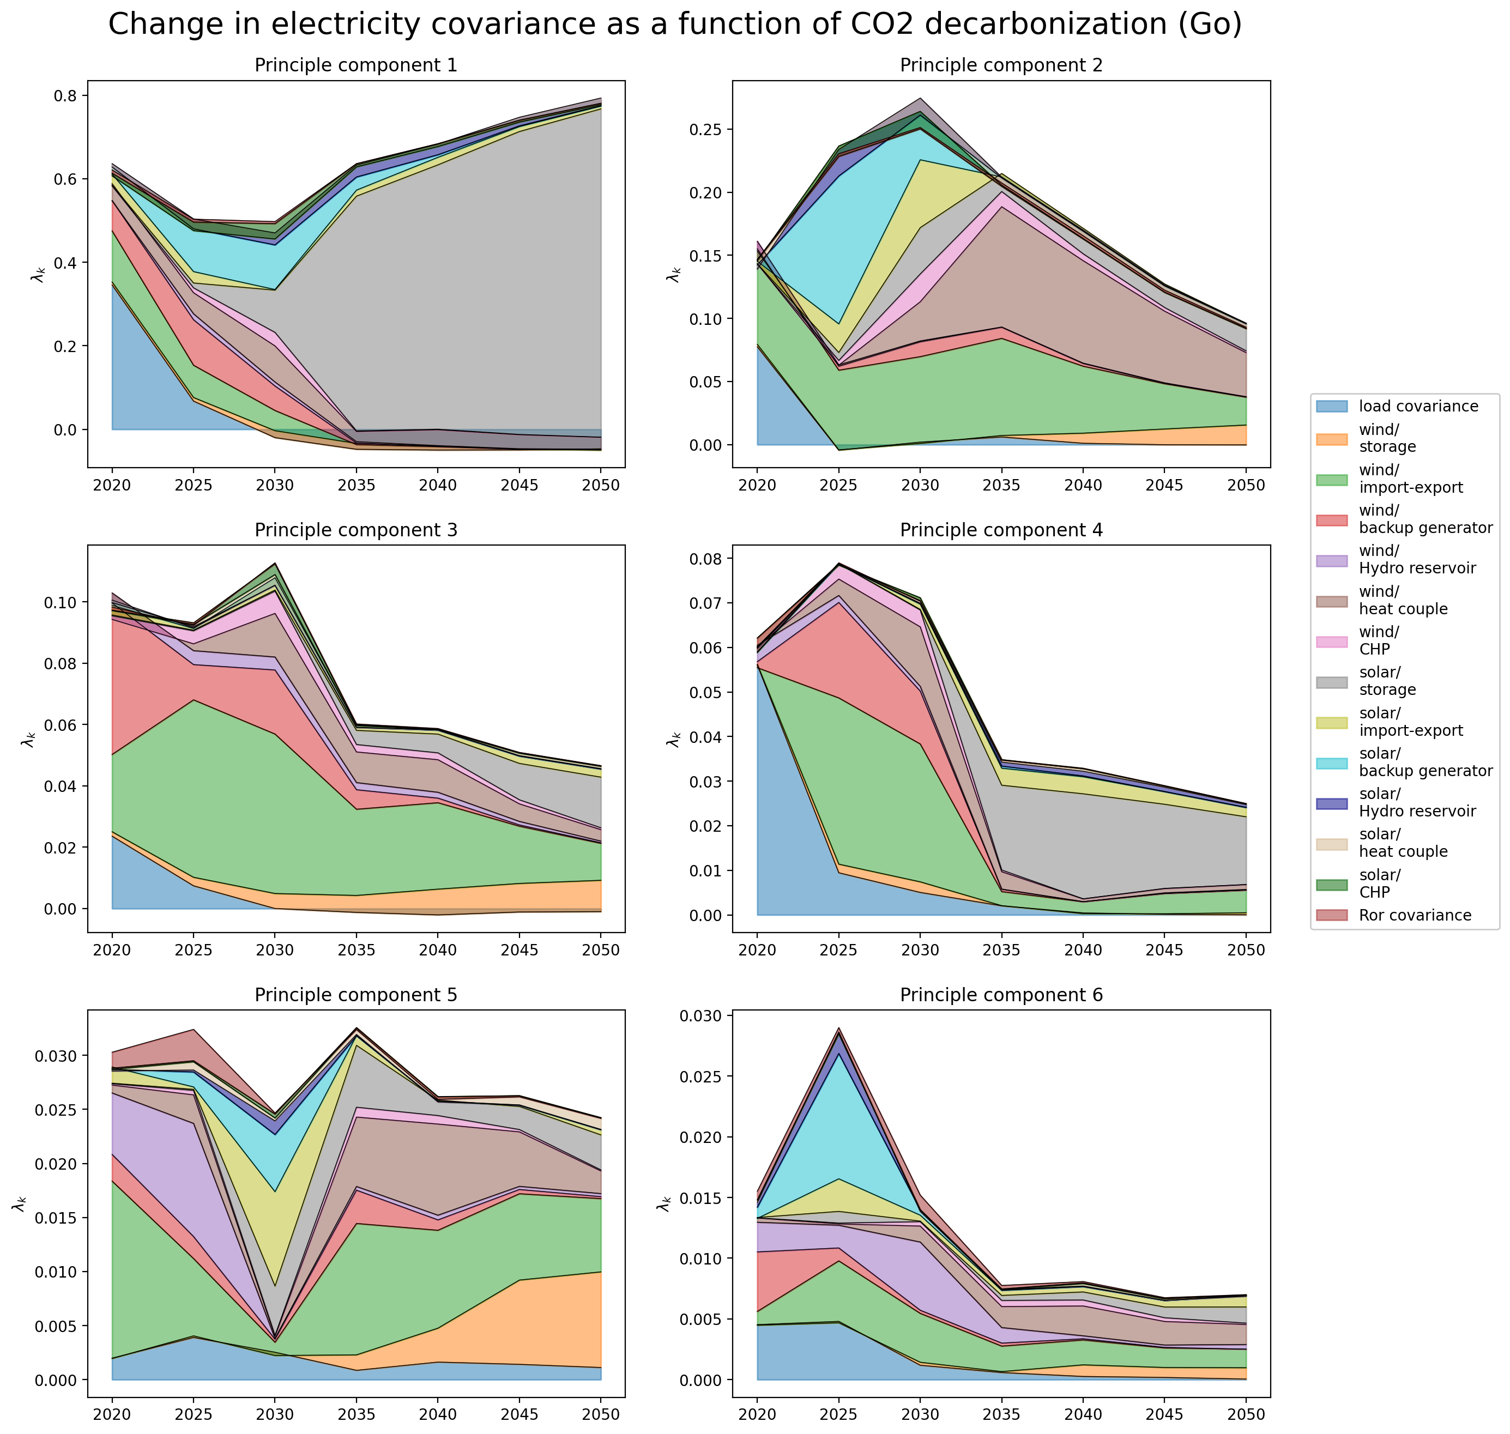
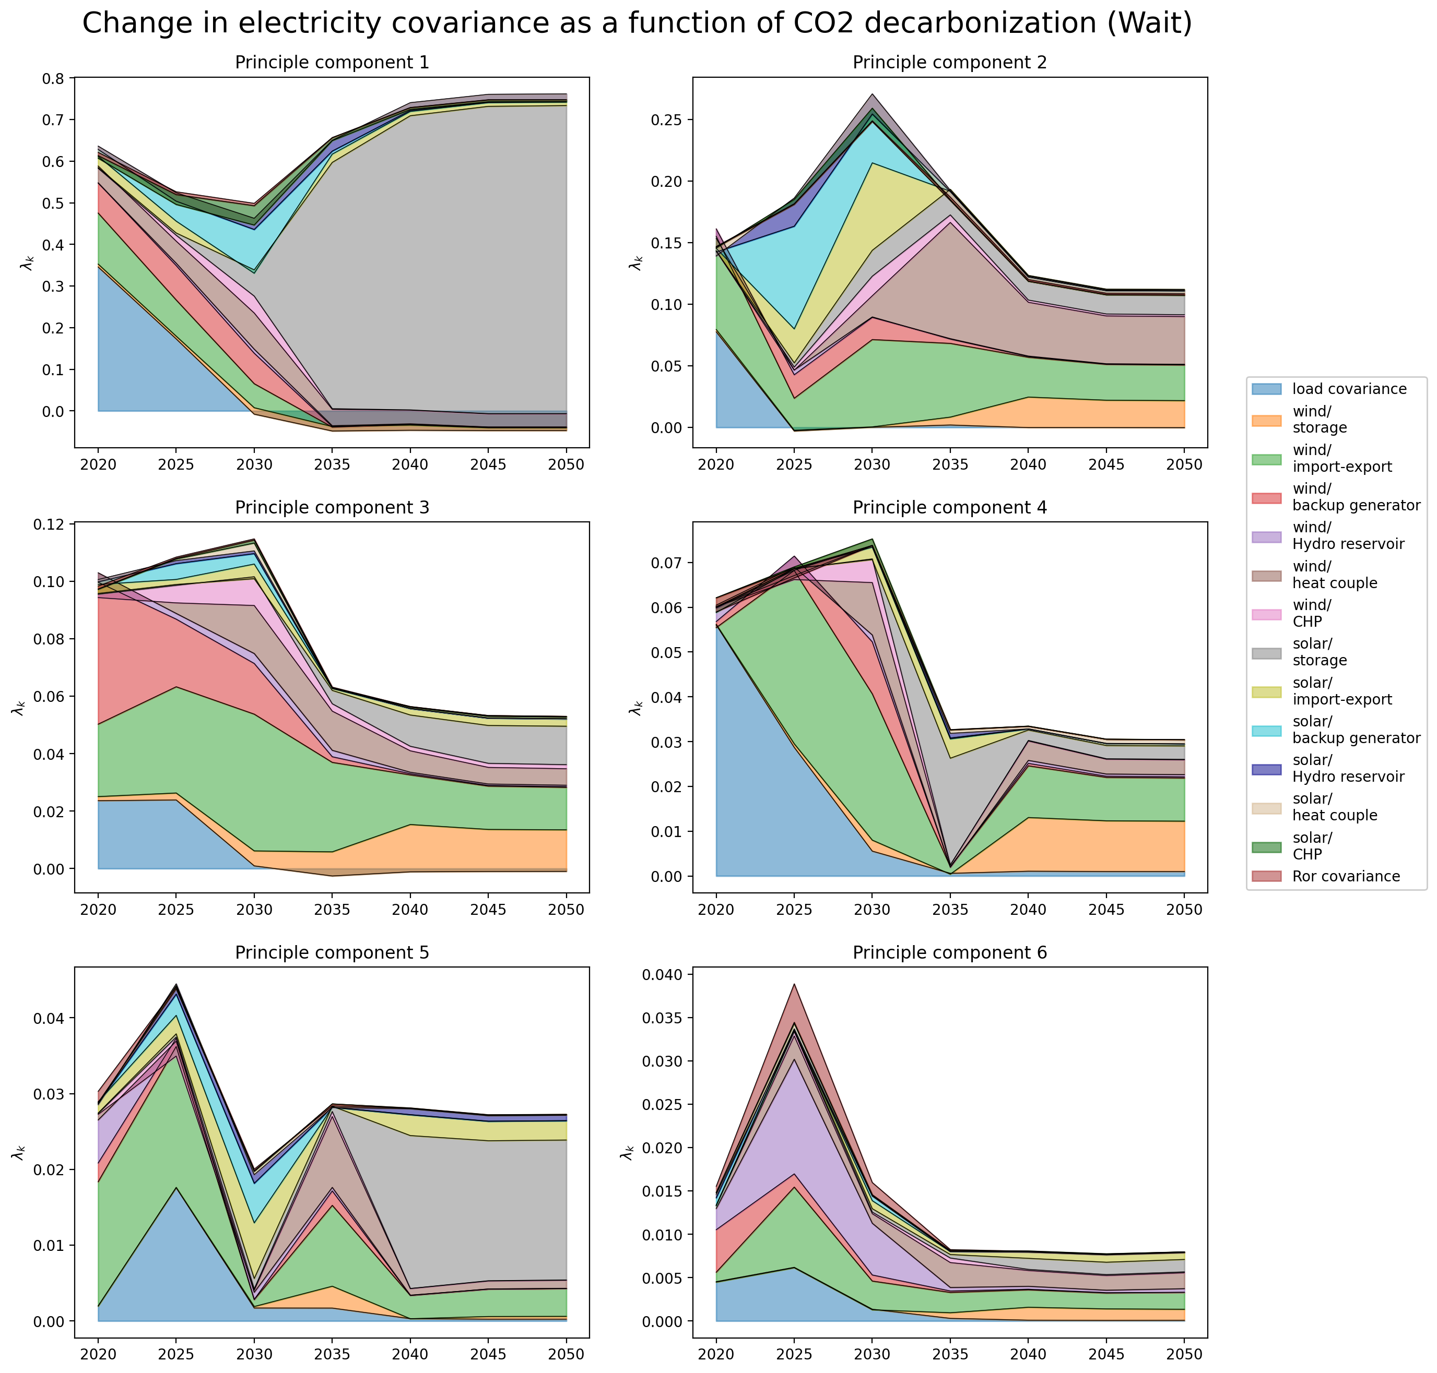
PCA – Change in Covariance

Slide 11
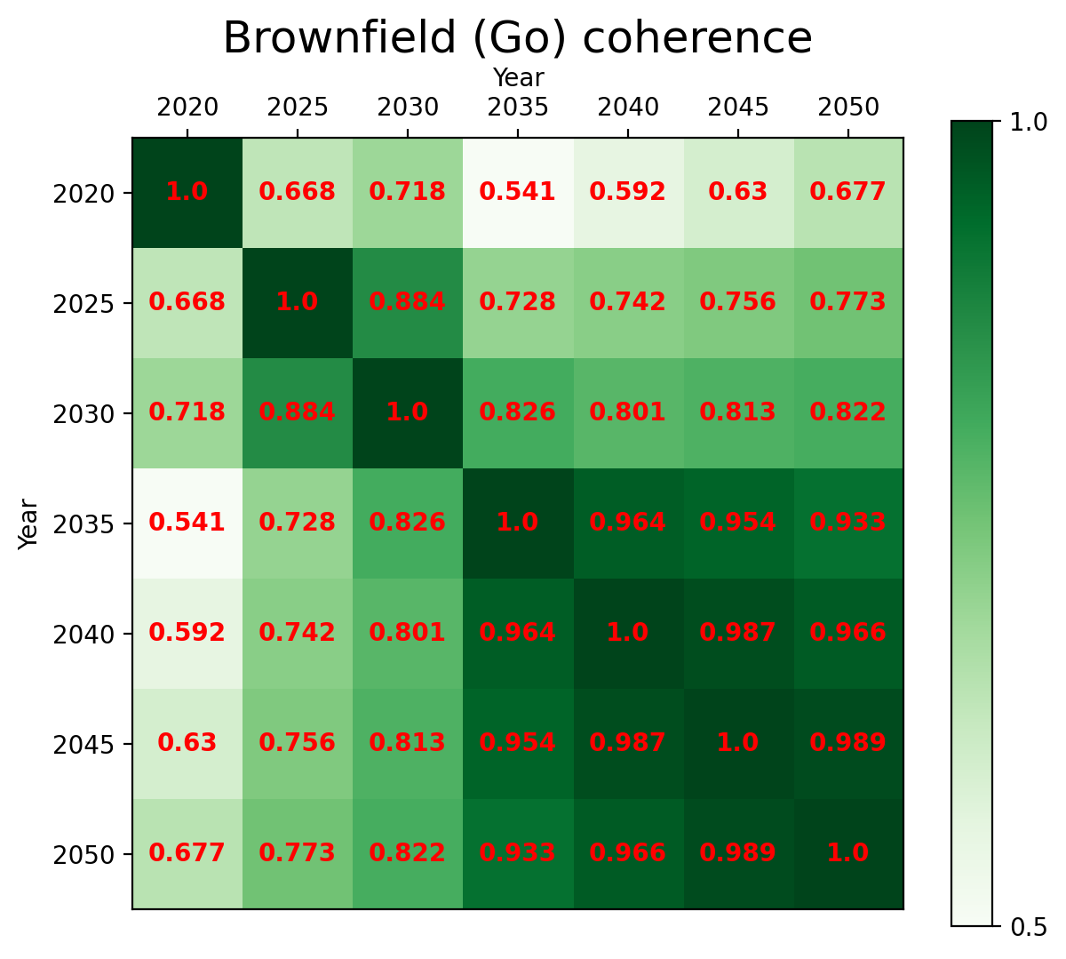
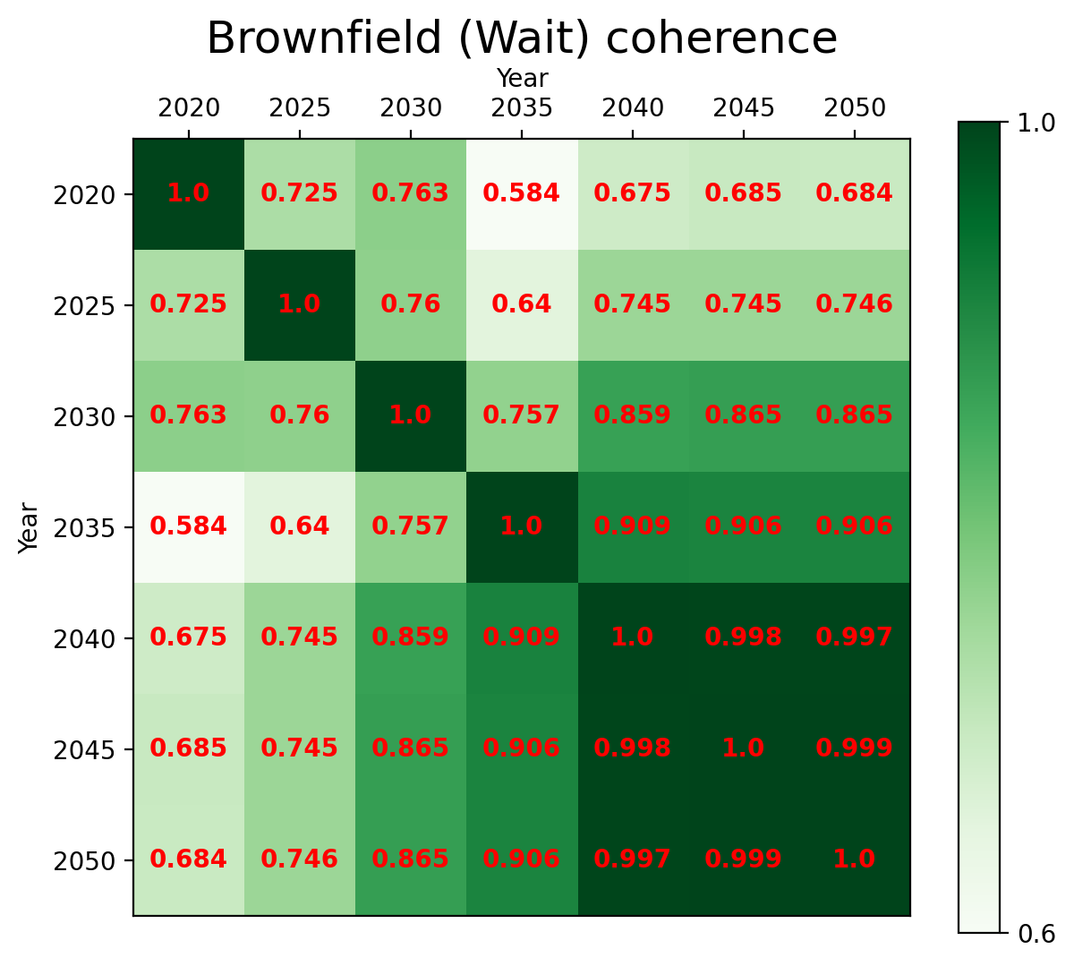
Coherence - Between Networks
Notes:
Coherence between go and wait

Slide 12
Transition Path
Heating Mismatch Analysis

Slide 13
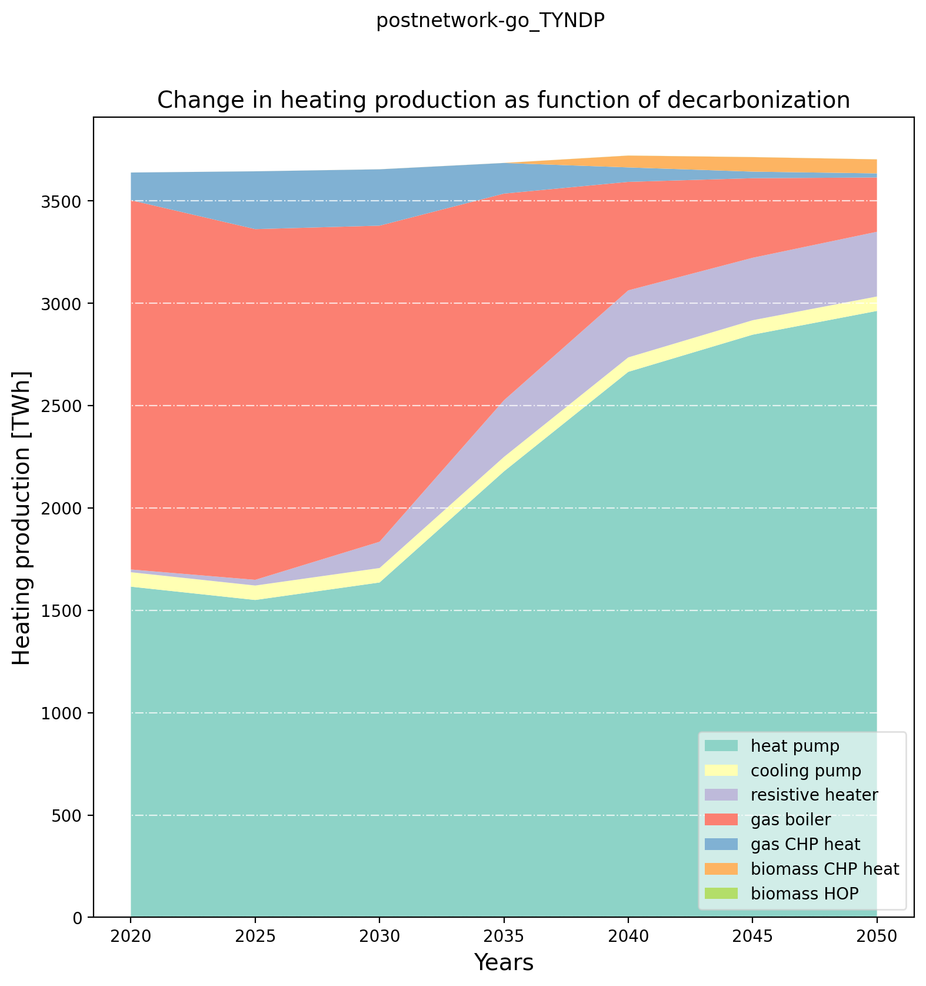
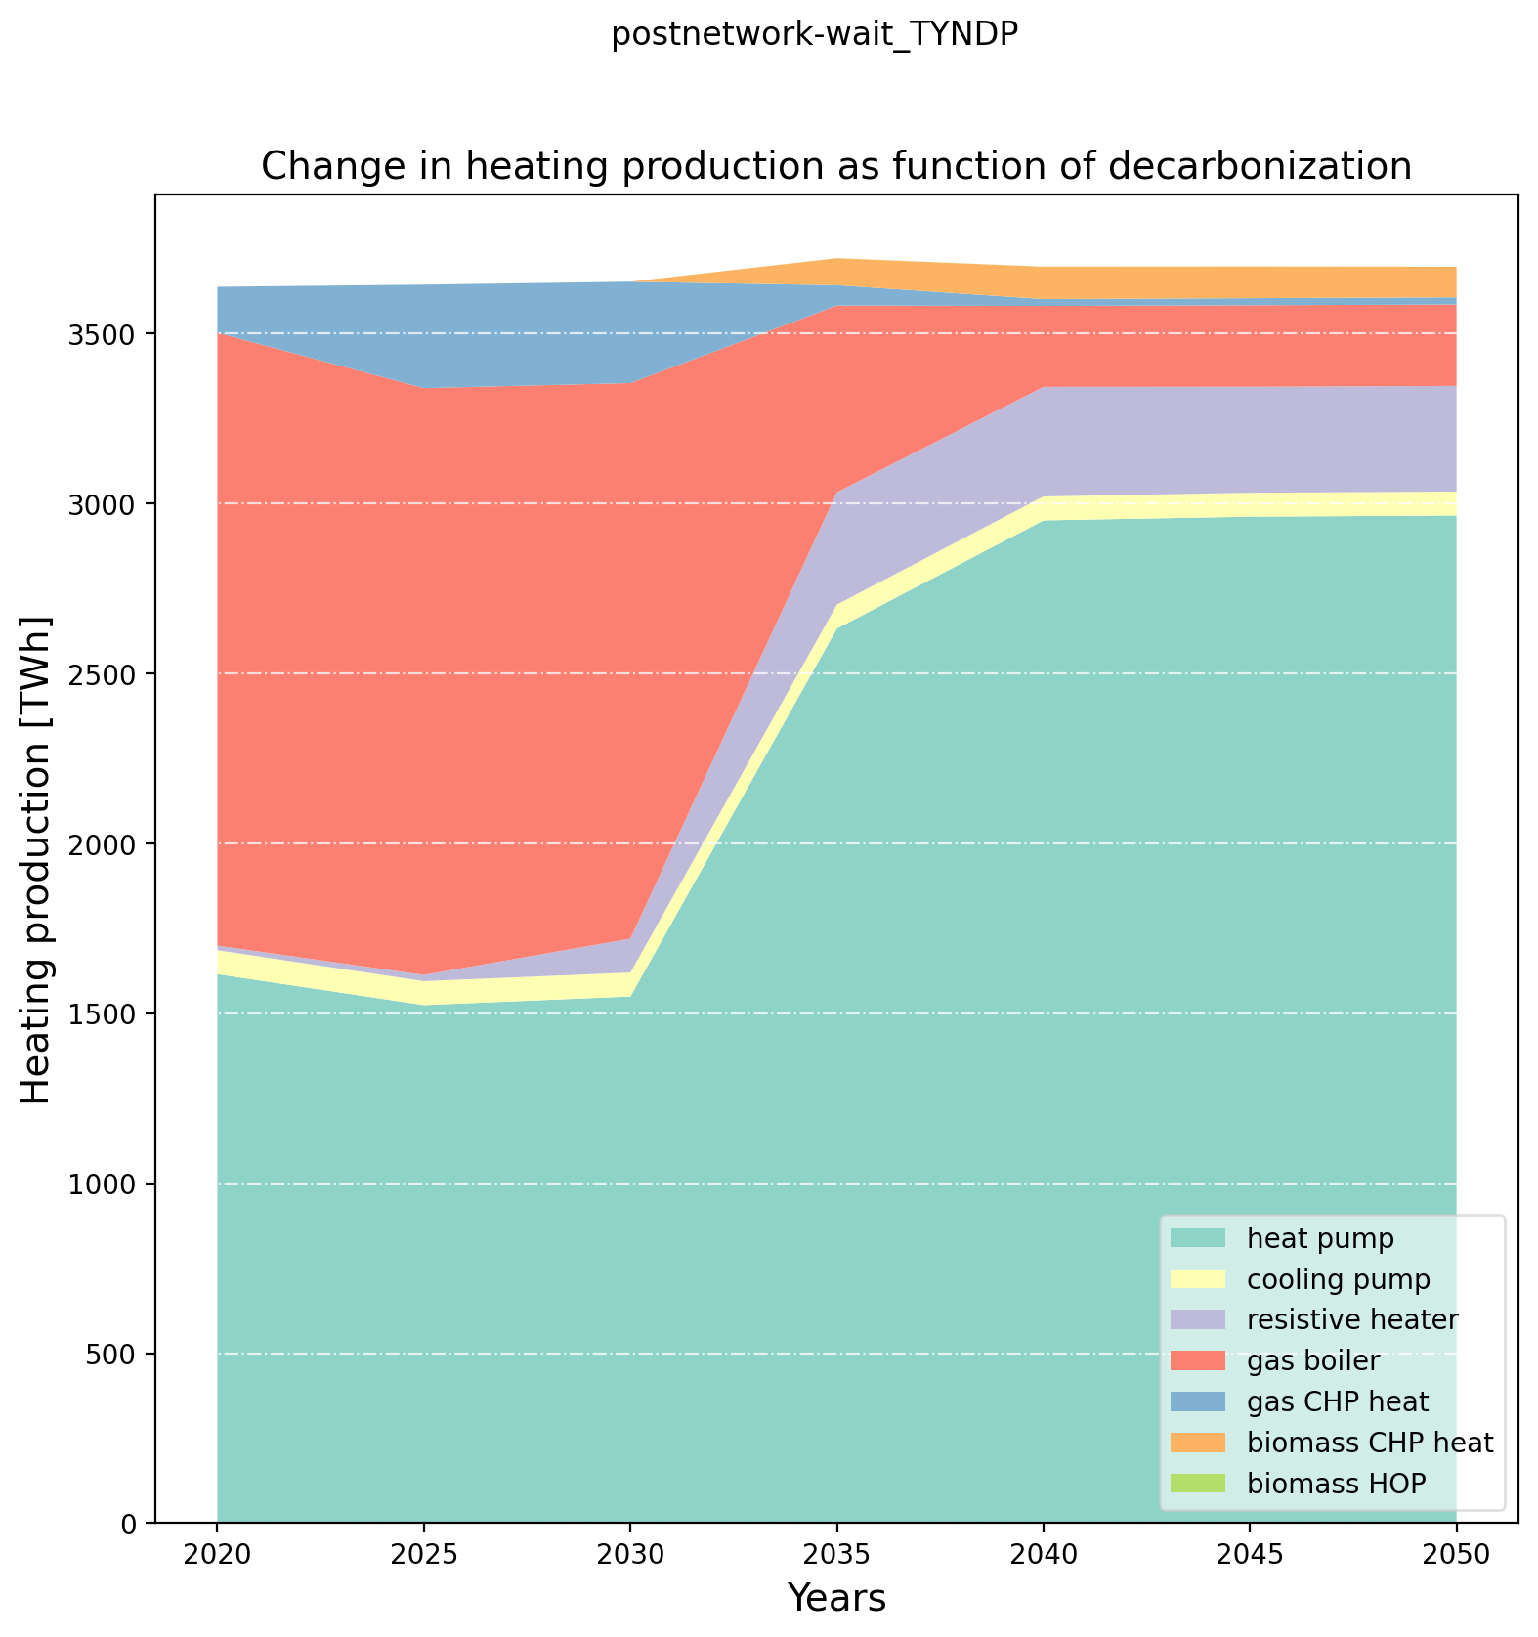
Pre-analysis – Heating Production

Slide 14
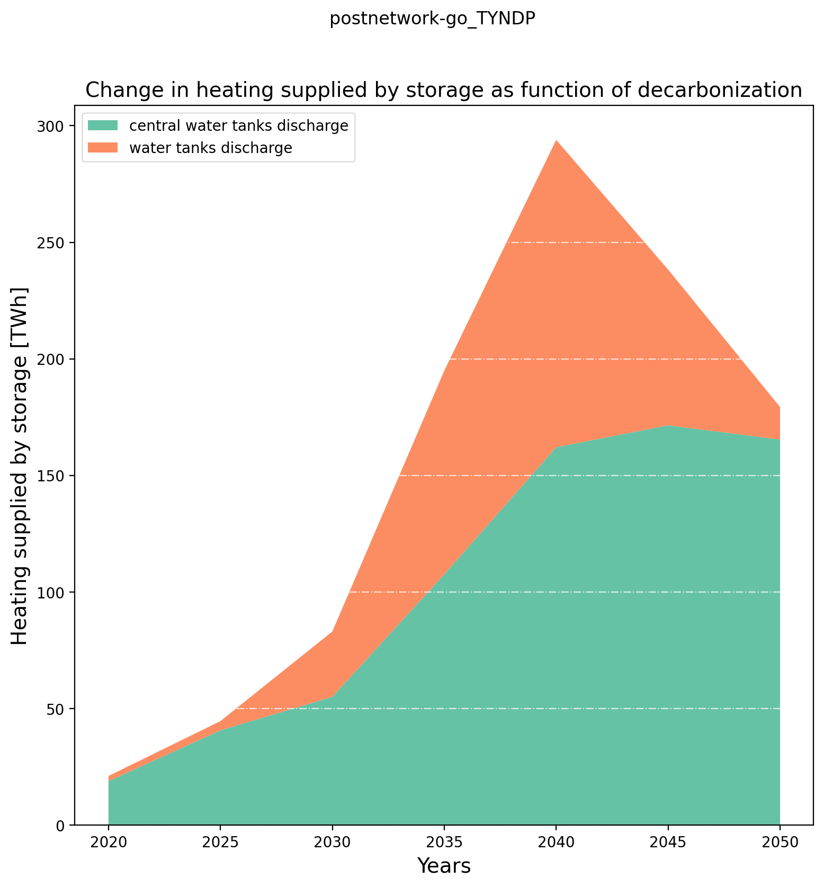
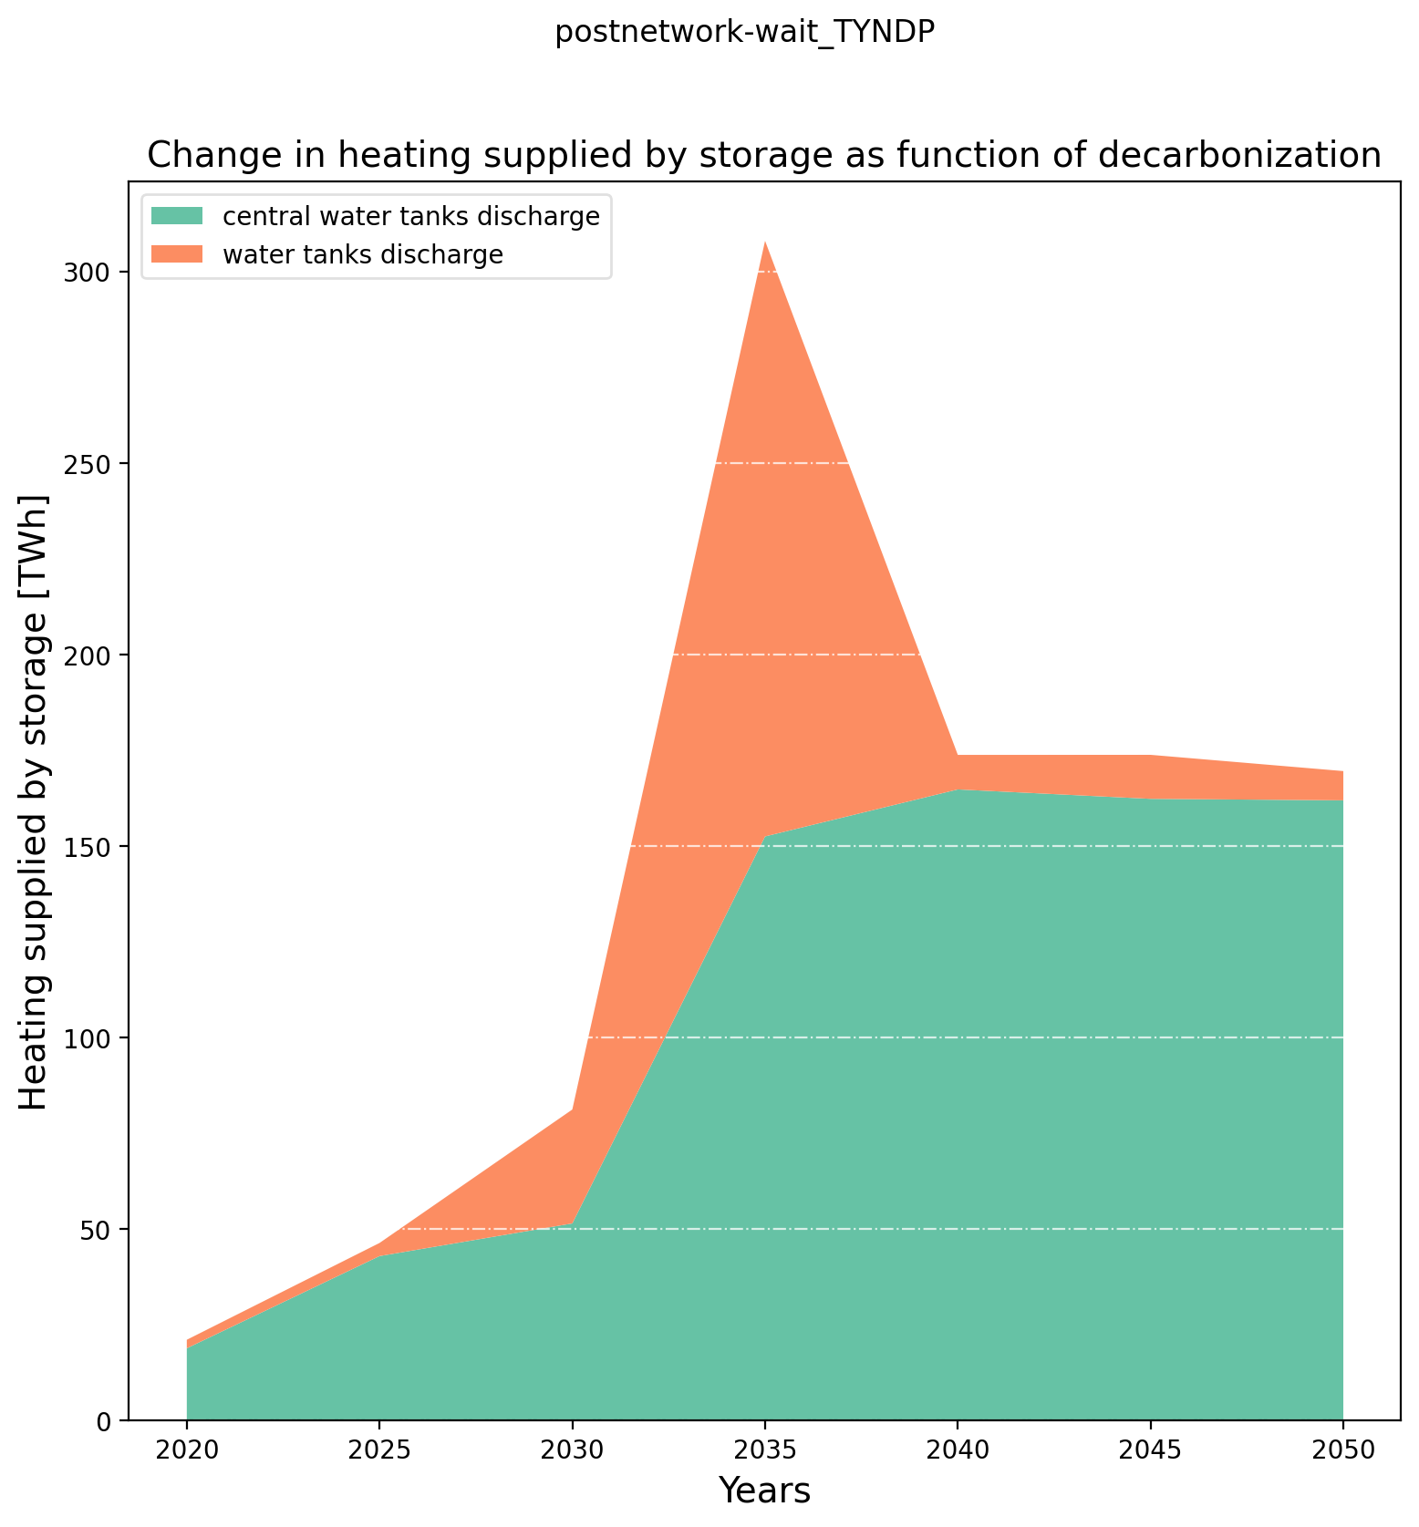
Pre-analysis – Heating Storage Production

Slide 15
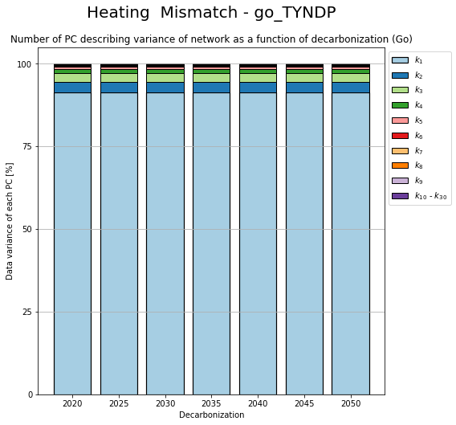

PCA – Change in components

Slide 16
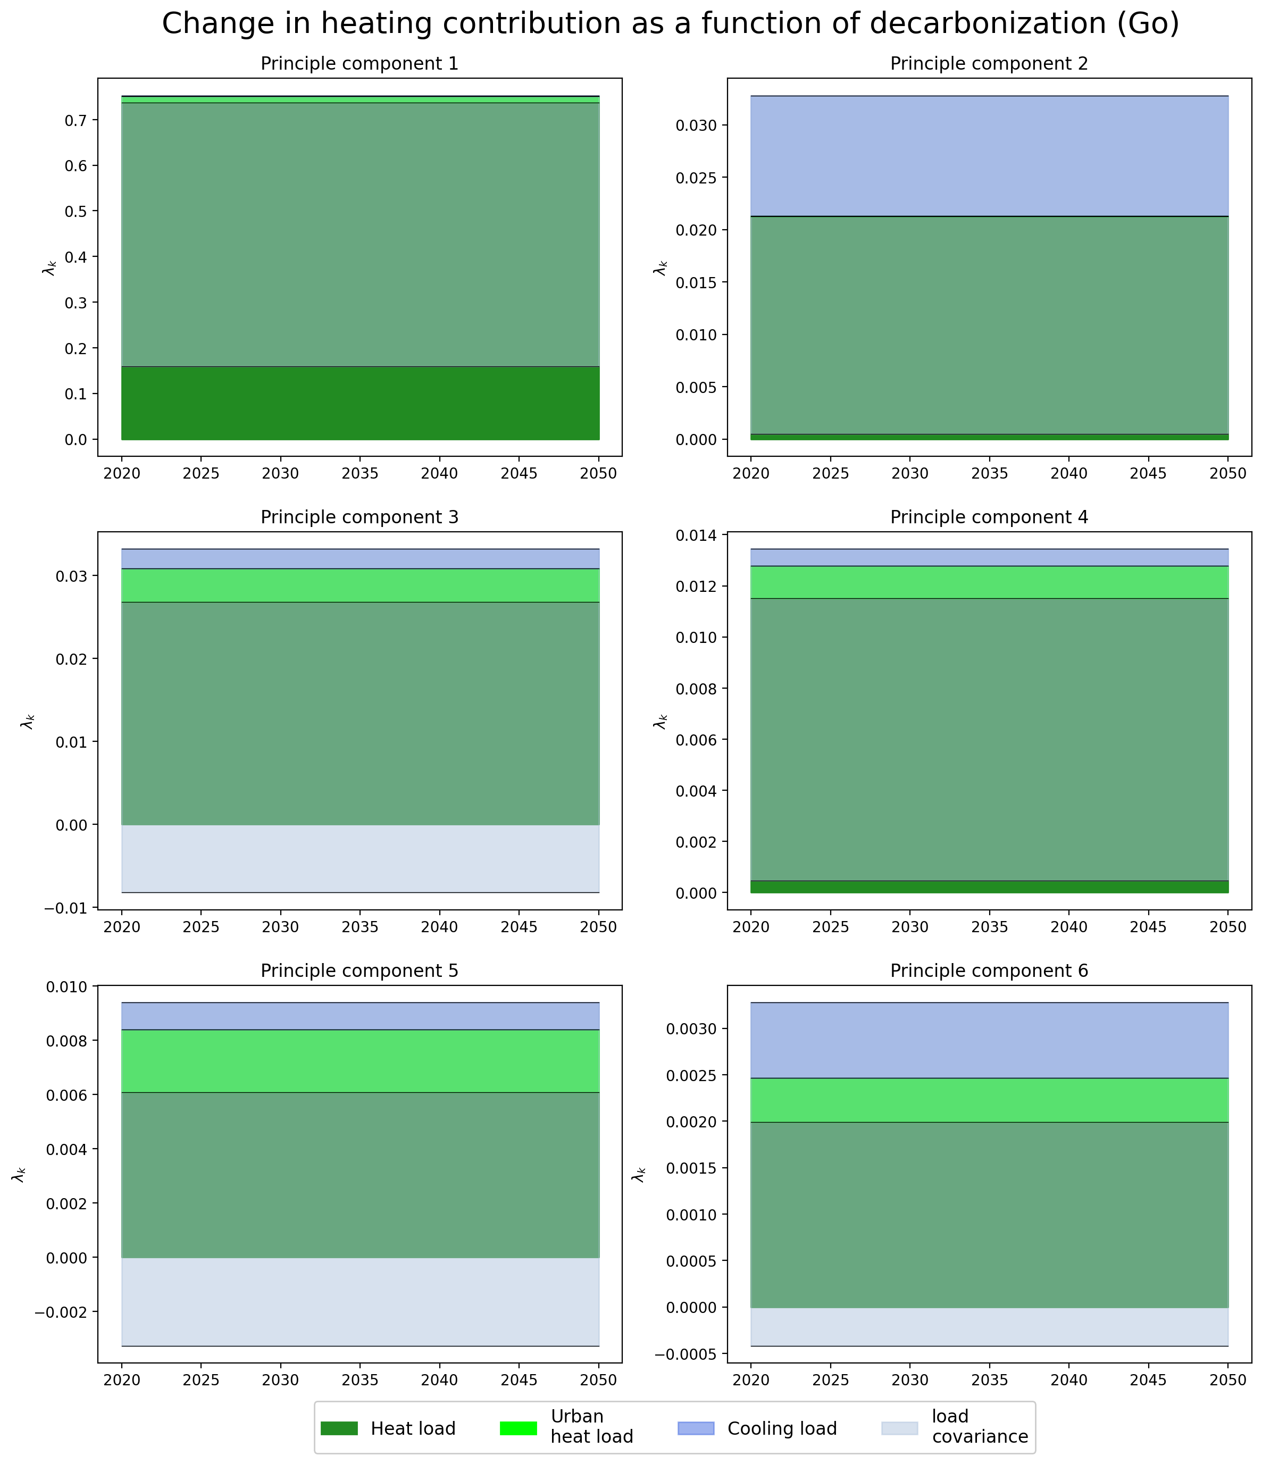

PCA – Change in Contribution

Slide 17
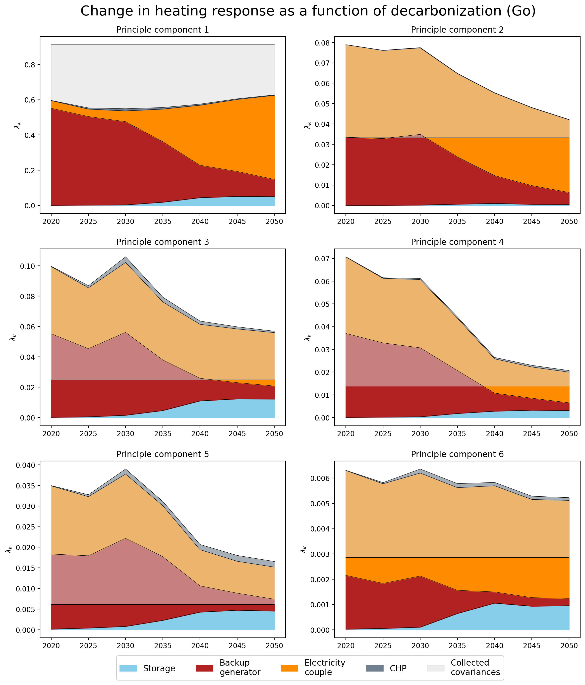
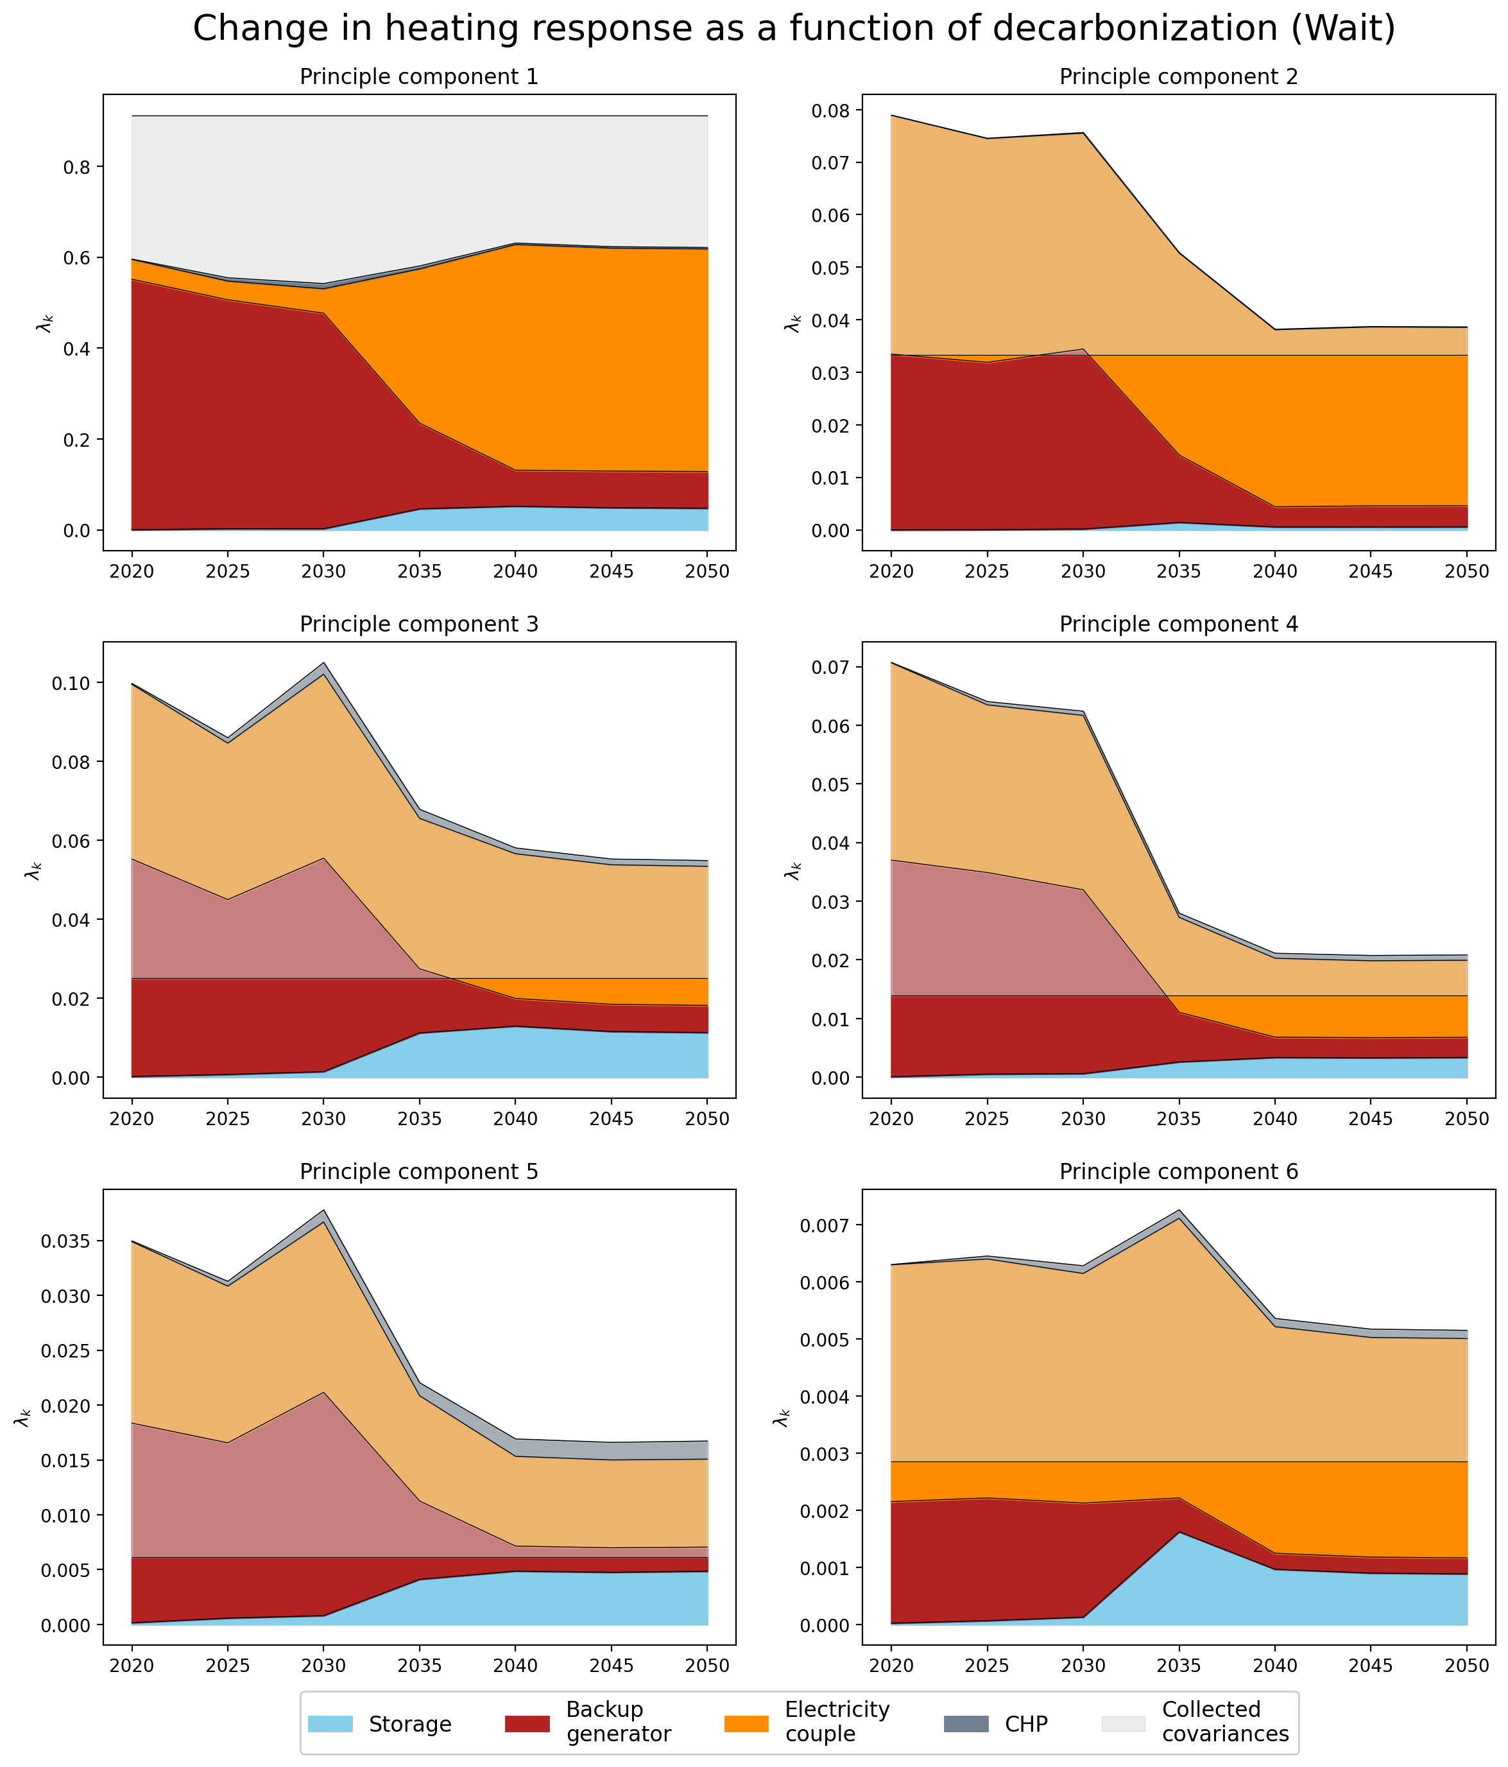
PCA – Change in Response

Slide 18
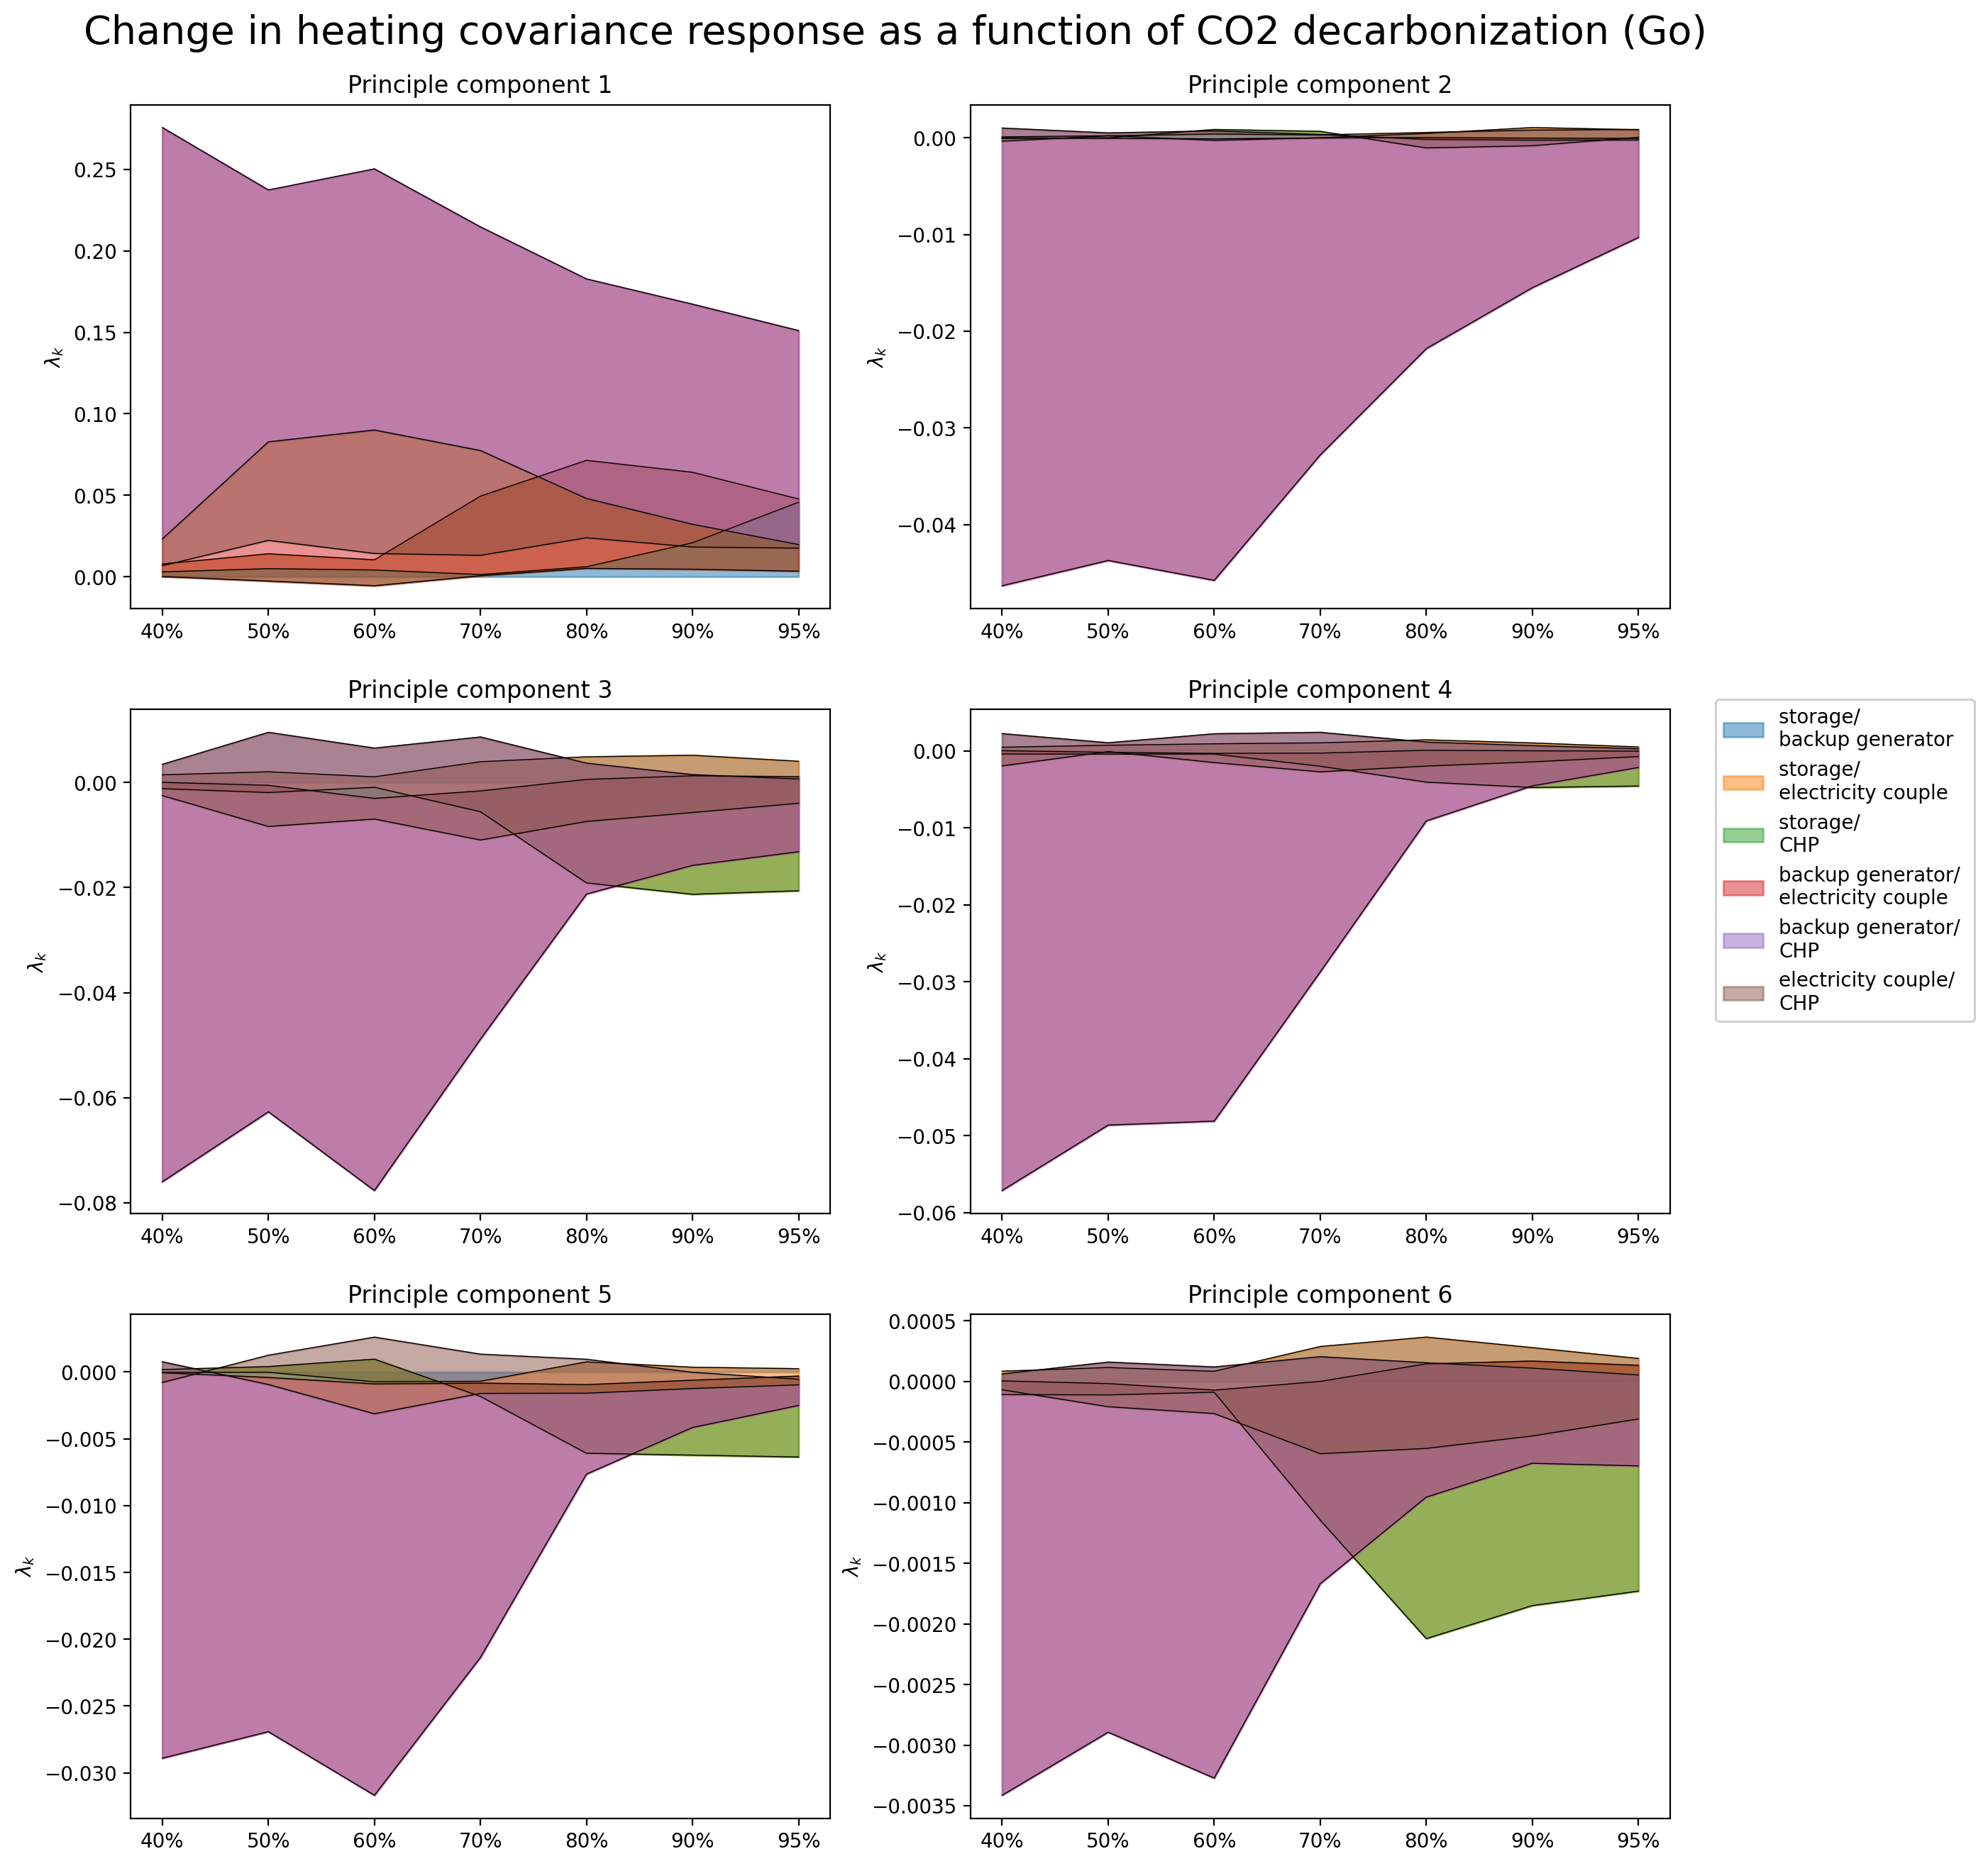
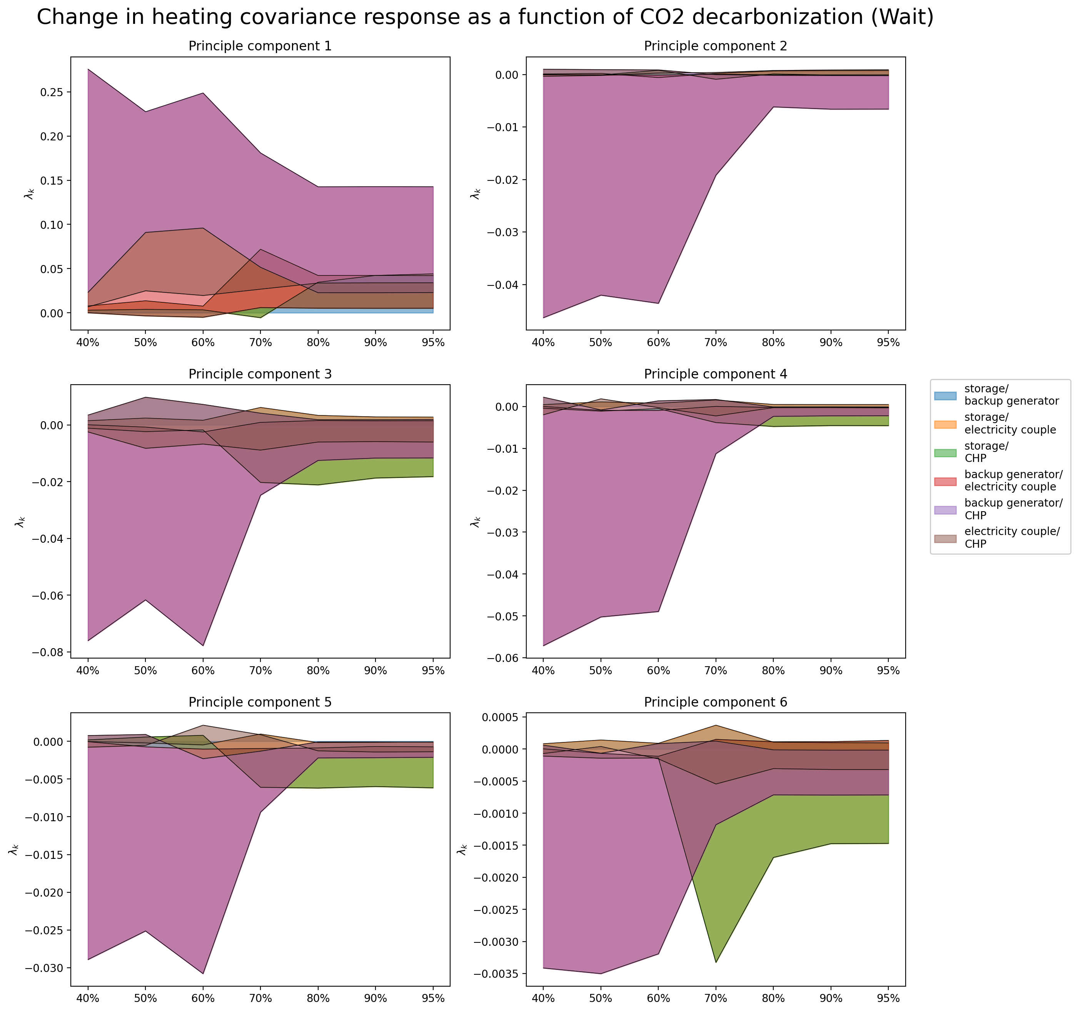
PCA – Change in Response (covariance terms)

Slide 19
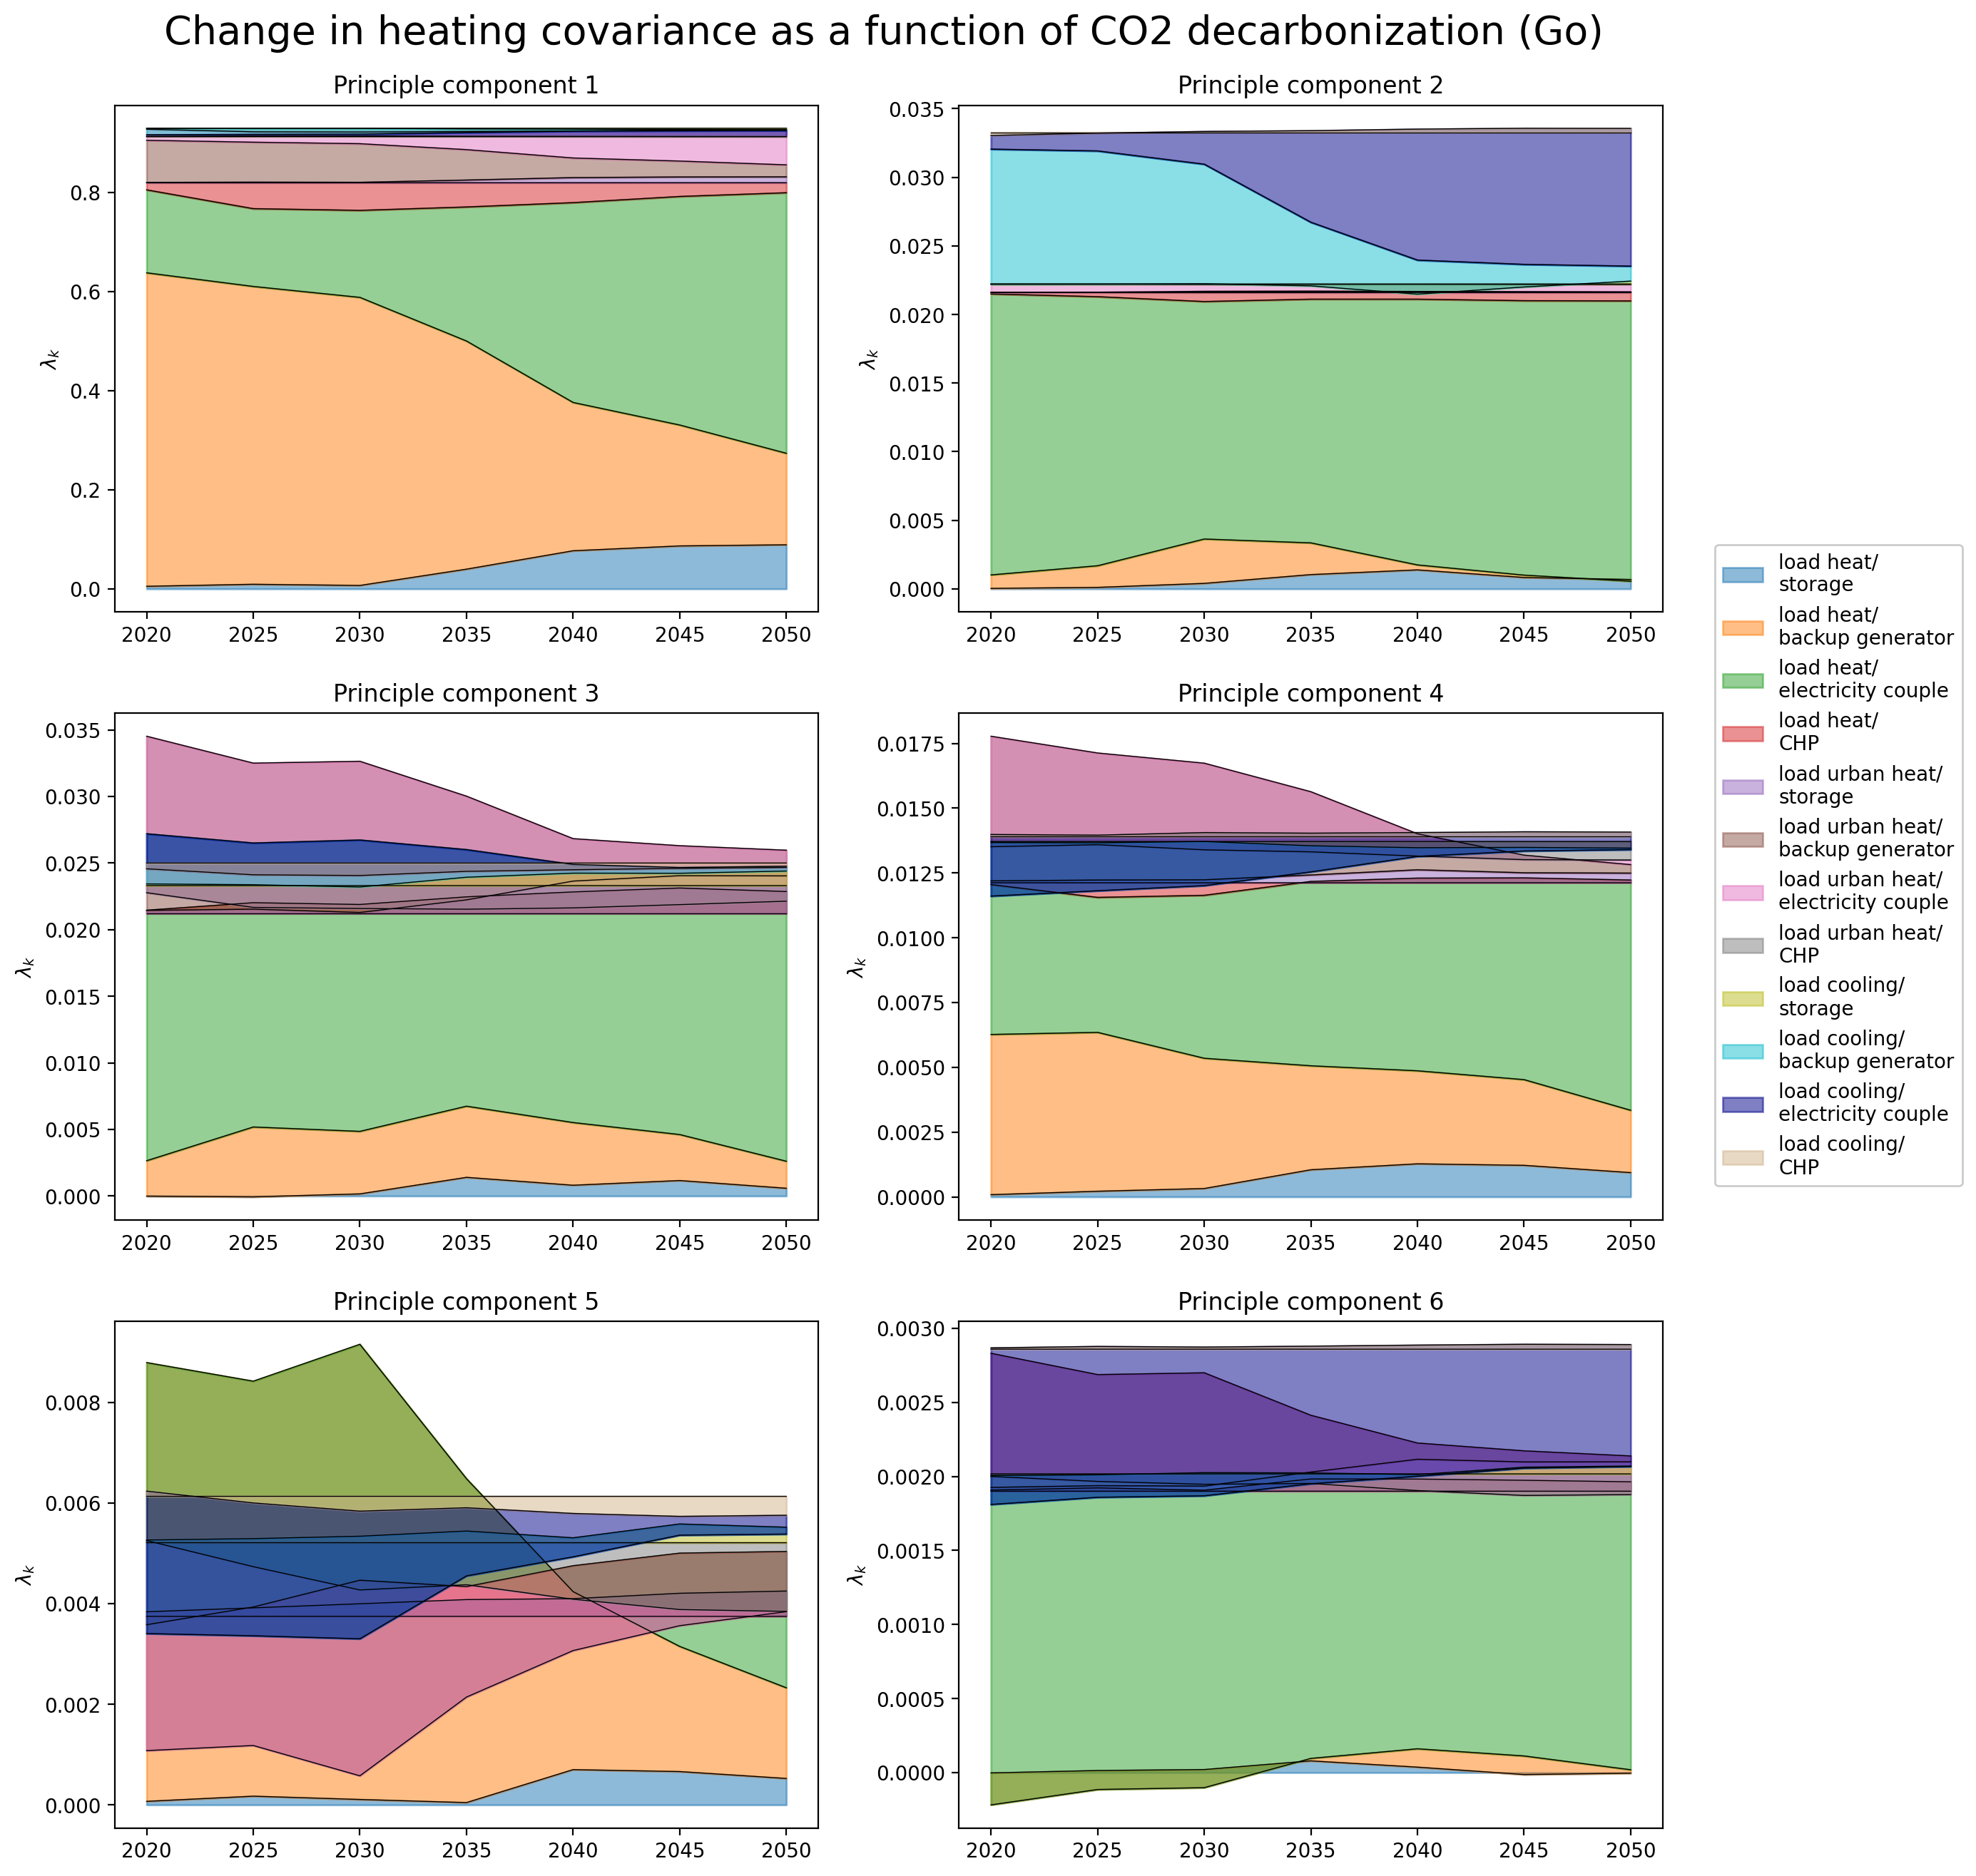
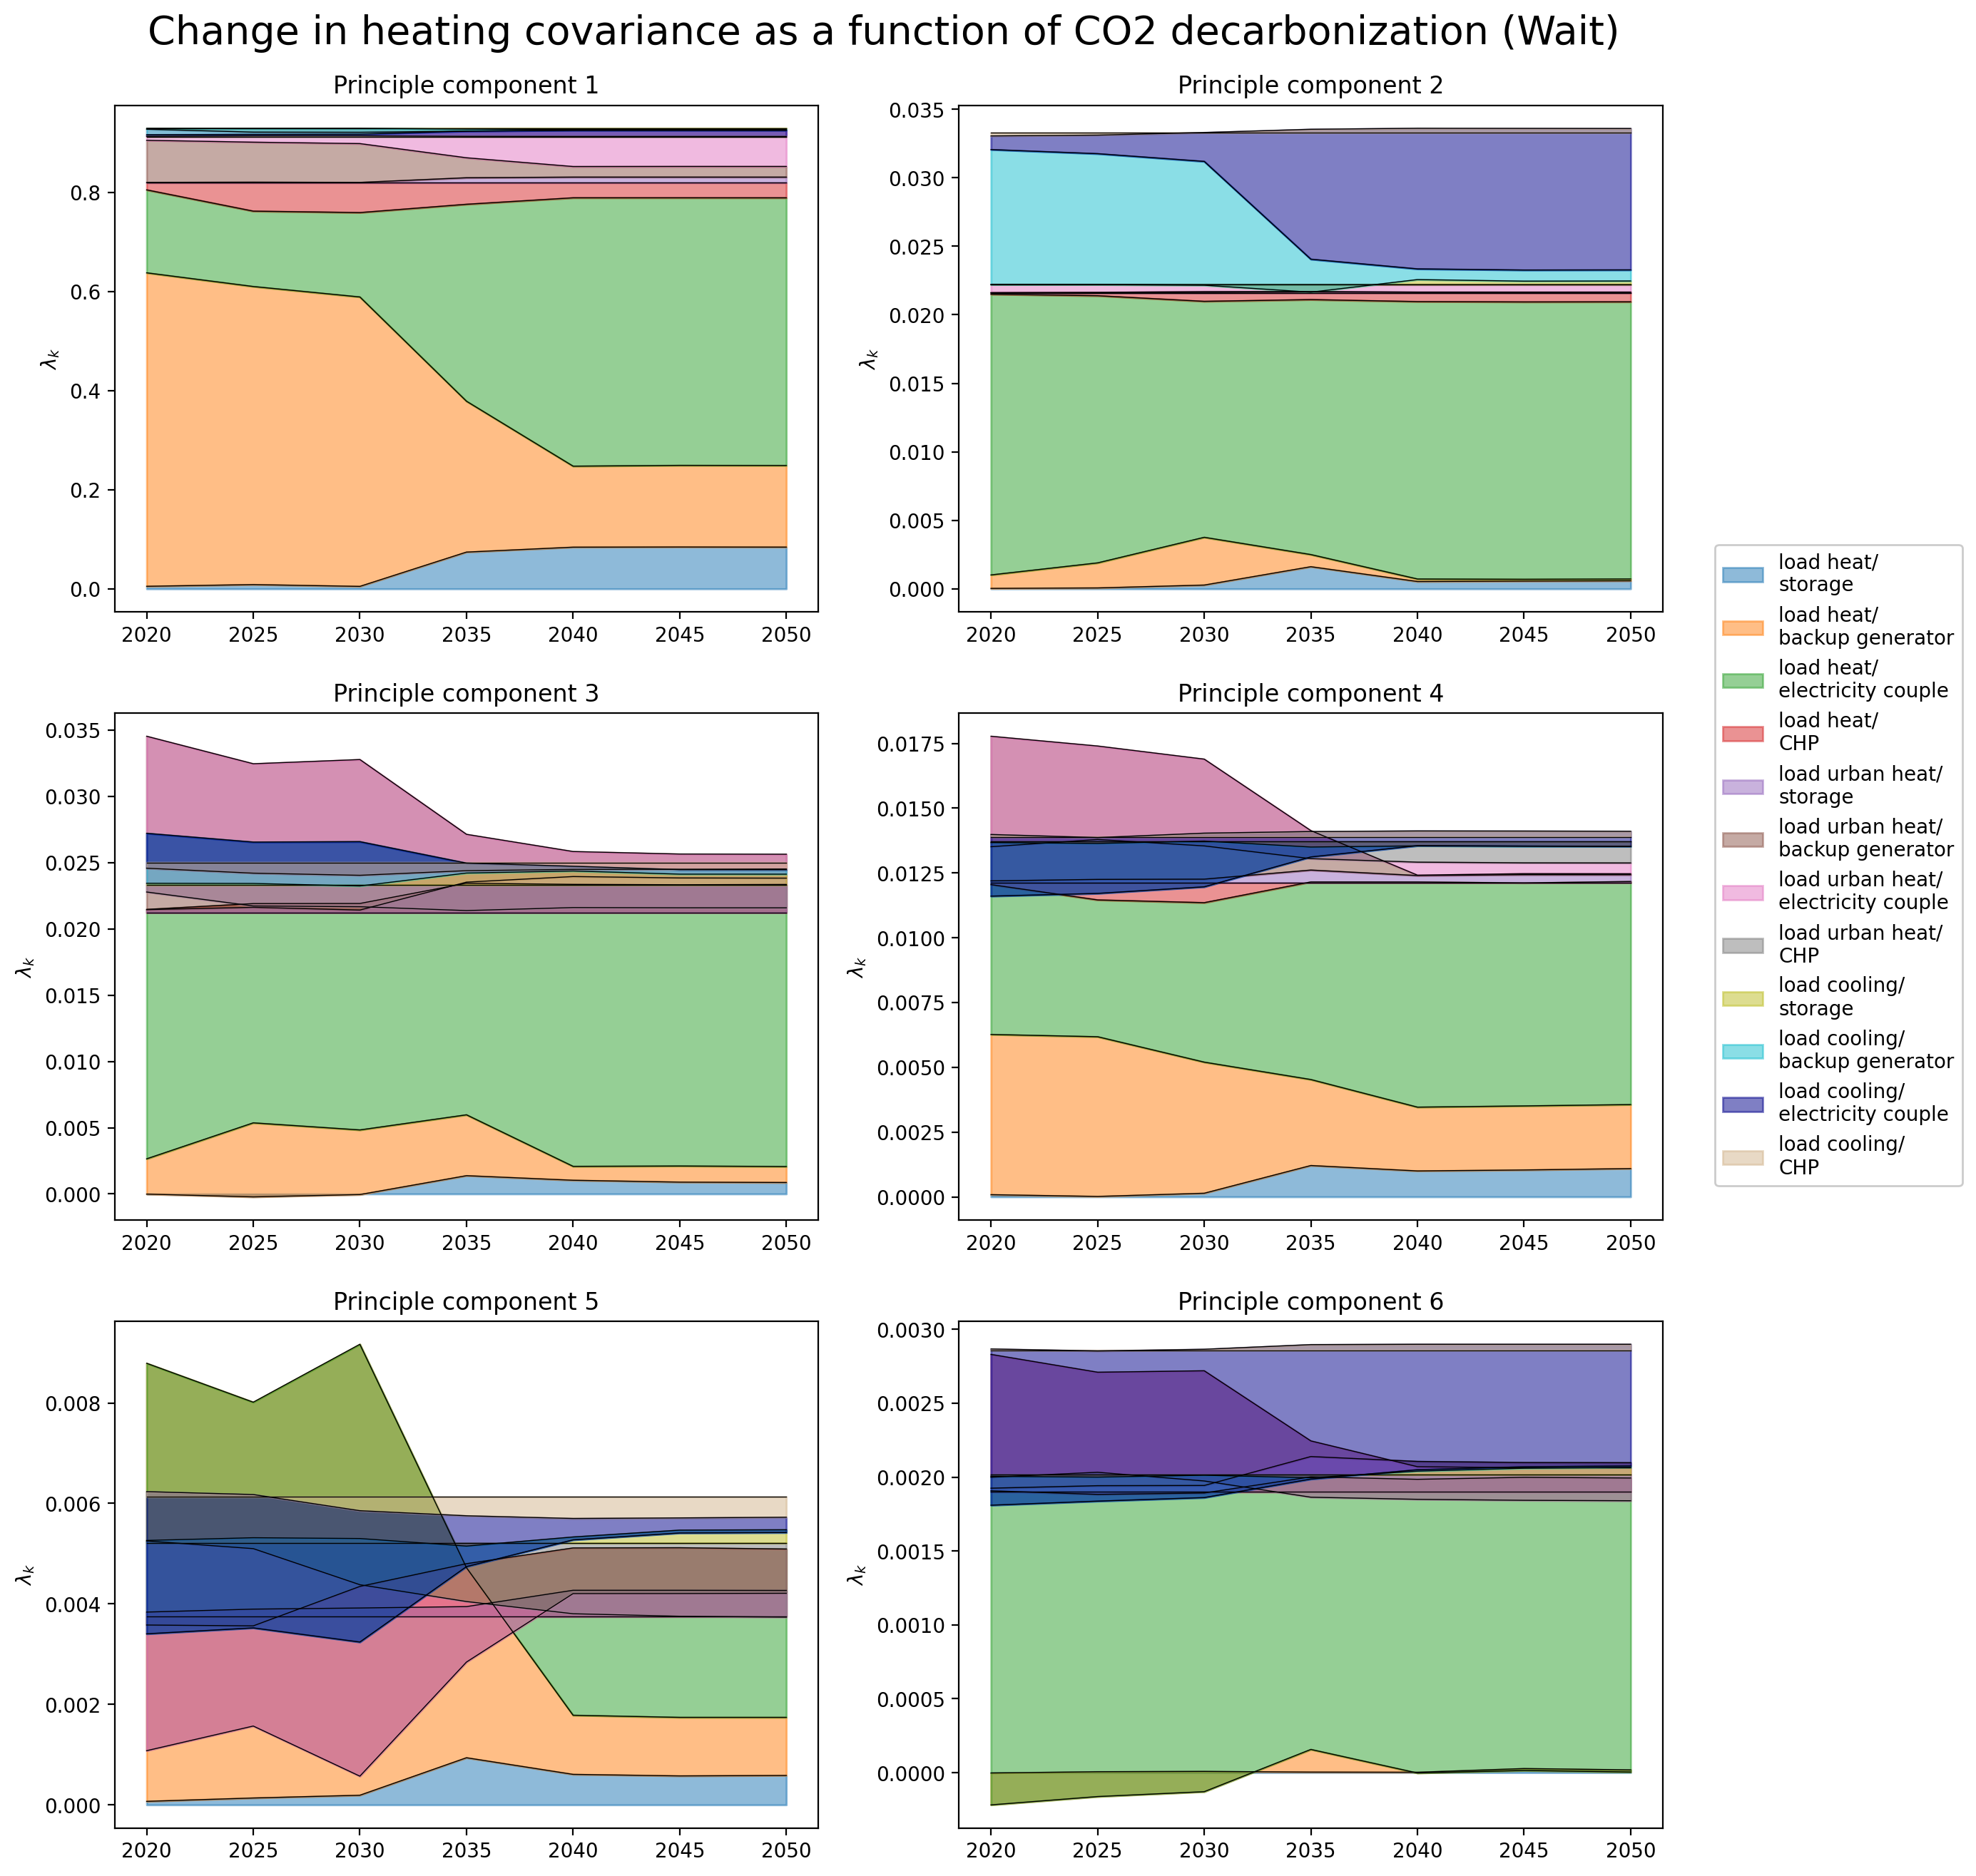
PCA – Change in Covariance

Slide 20
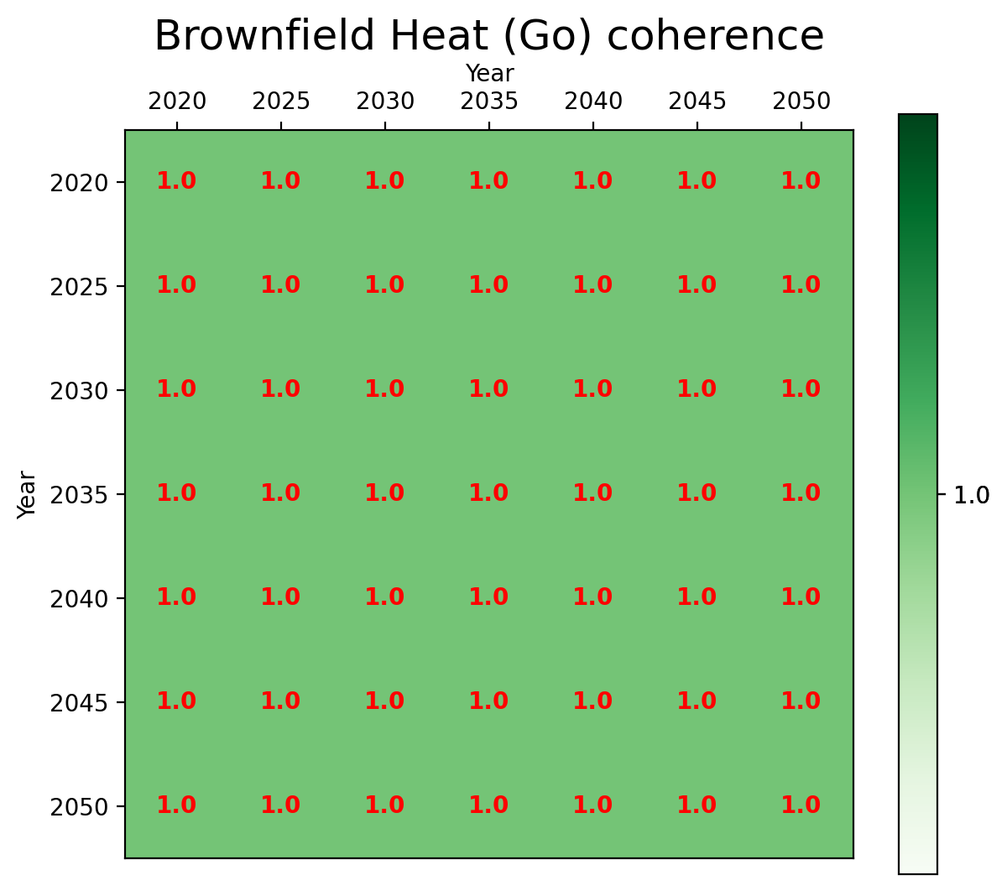

Coherence - Between Networks

Slide 21
Transition Path
Electricity Mismatch Analysis

Slide 22
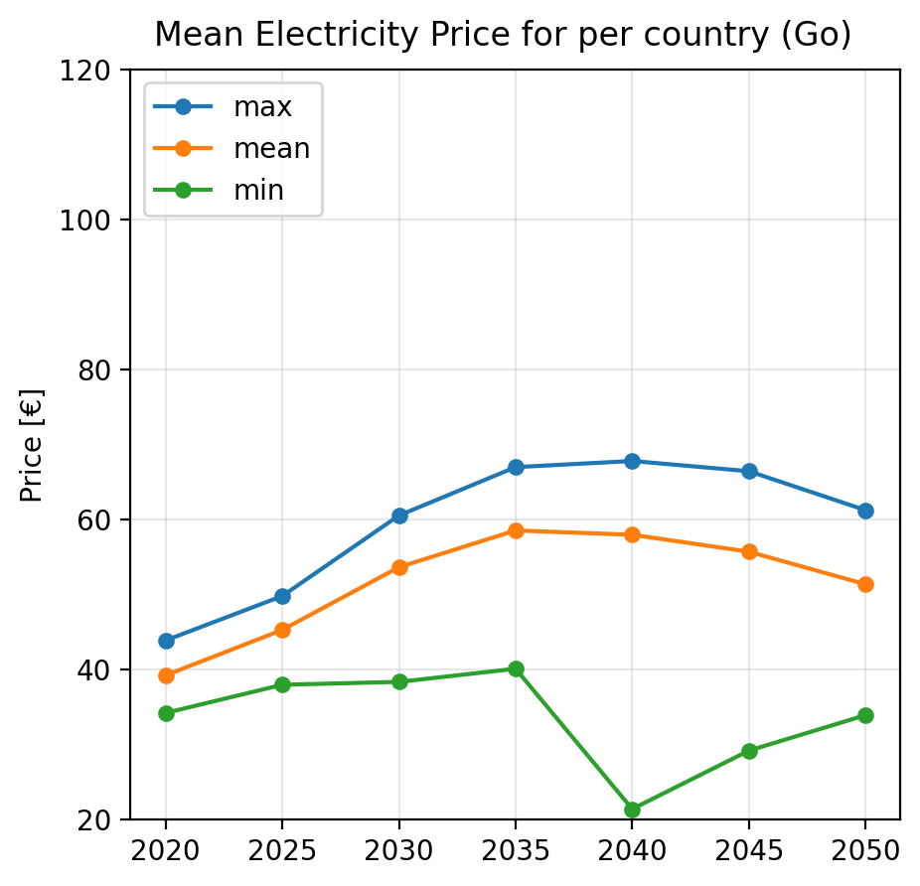
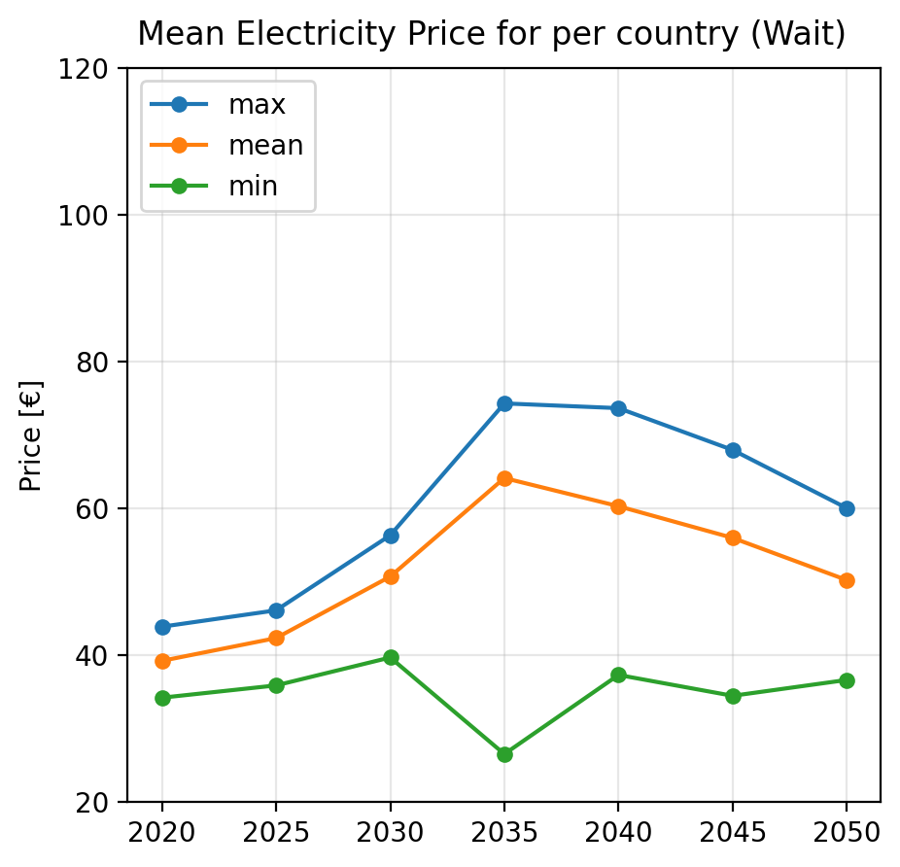
Pre-analysis – Mean values
Notes:
Prøv at vende det om så først tag min() / max() og derefter tag mean() på tværs af dem
Kig på arealet under kurven

Slide 23
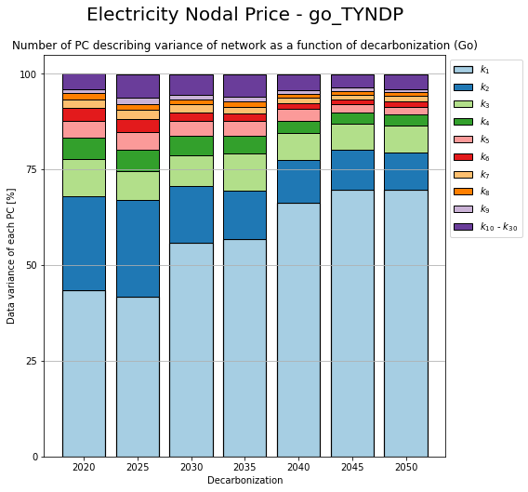
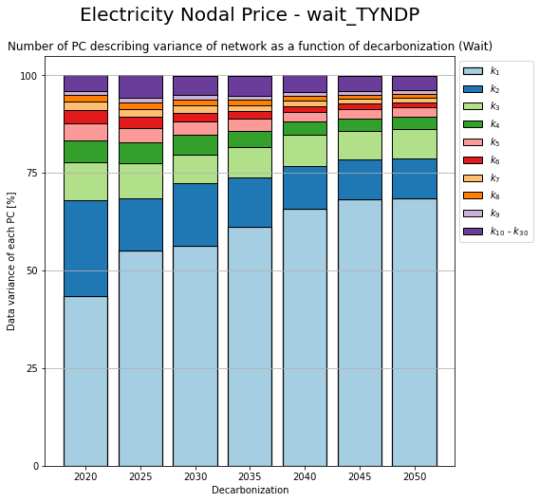
PCA – Change in components

Slide 24
Transition Path
Electricity Mismatch Analysis

Slide 25
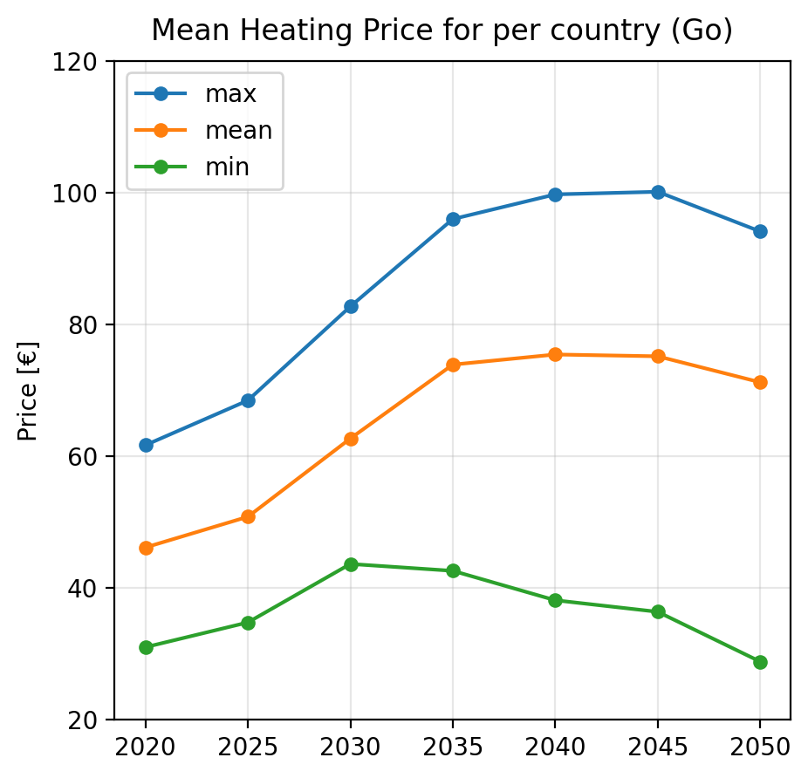
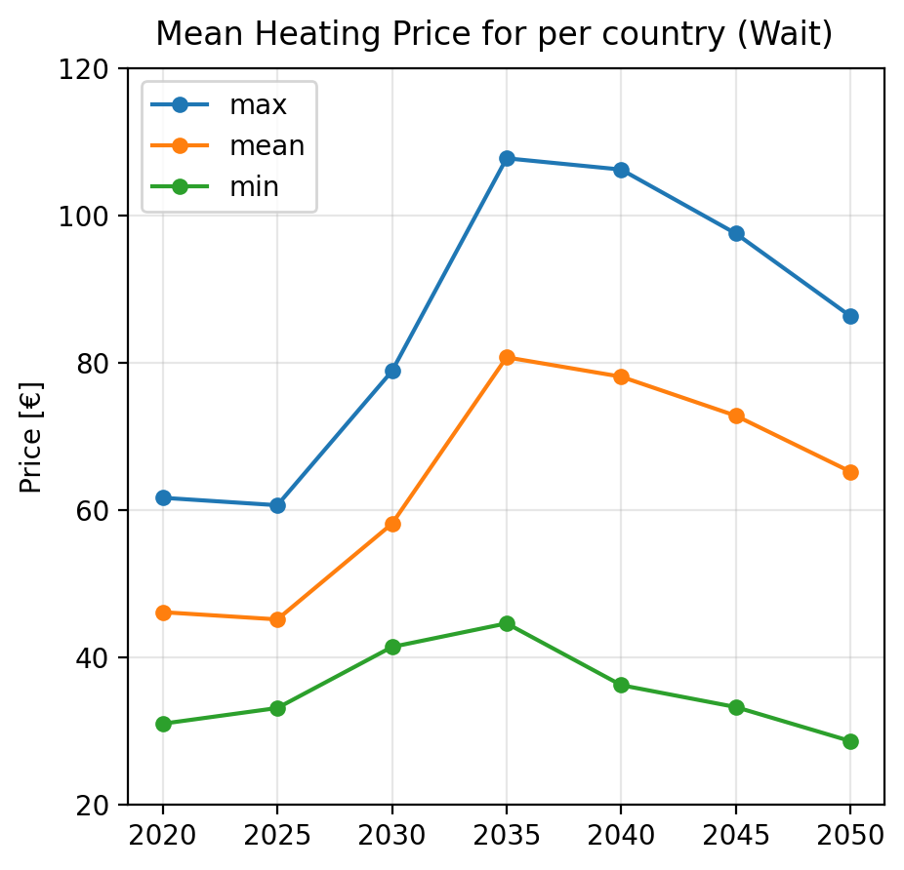
Pre-analysis – Mean values

Slide 26
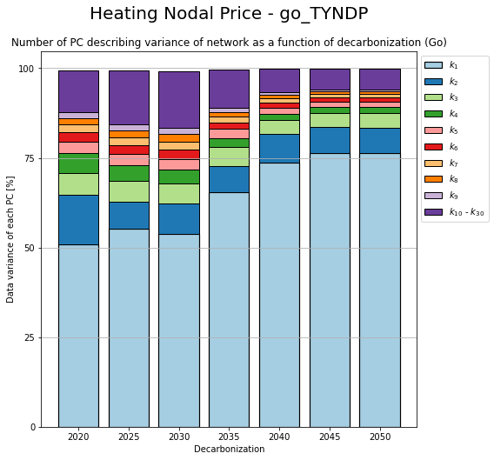
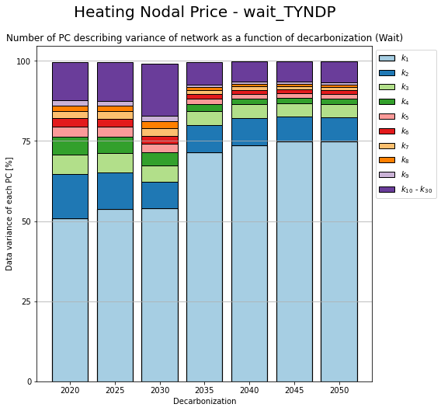
PCA – Change in components

Slide 27
Transition Path
Between mismatch and price

Slide 28
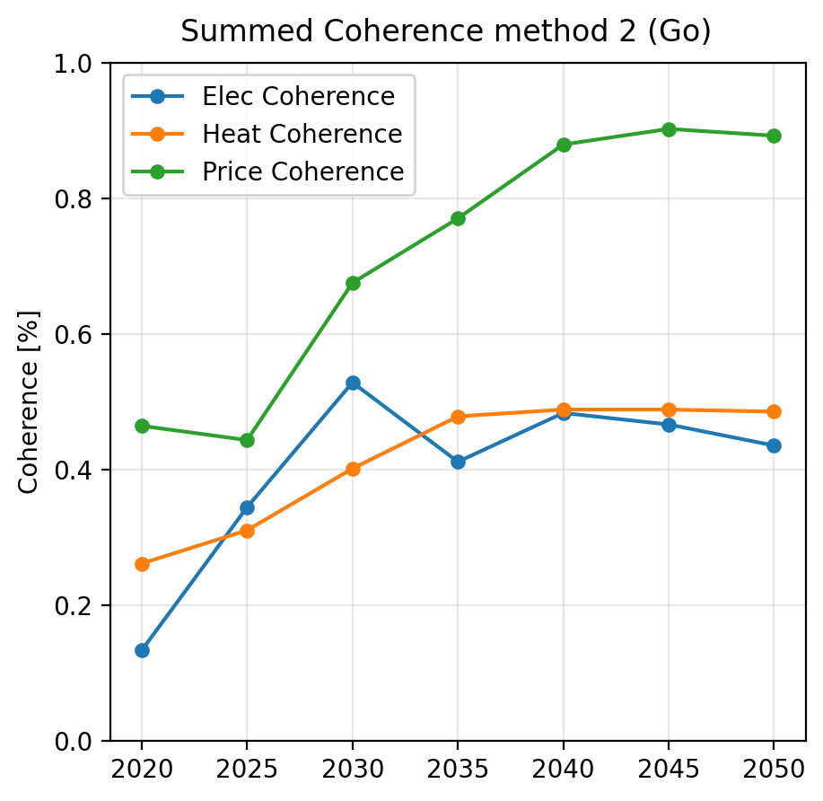
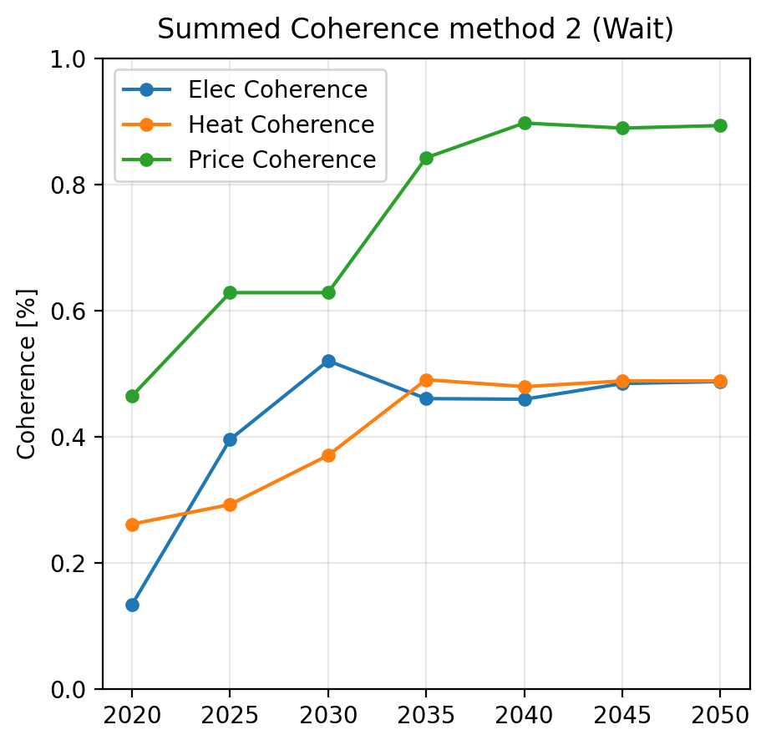
Coherence – Method 2

